Slide 1


Class of 1976
In loving memory of our
classmates who have passed (1976 -2026)
Music Credit: Sentimental Moments by Pumpupthemind sourced from Free Music Archive (CC BY-NC-ND)

Slide 2
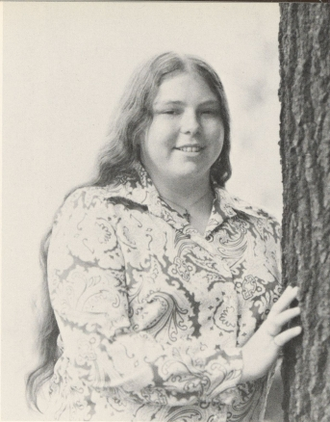
Deborah (degrave) Ayres
1954 - 2024

Slide 3
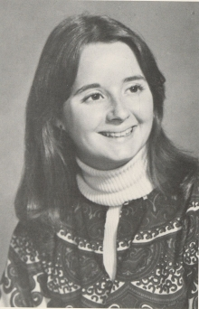
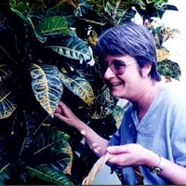
Margaret “Midge” (Aughinbaugh) Bailey
1954 - 2022
Obituary

Slide 4
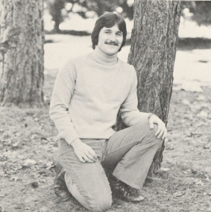
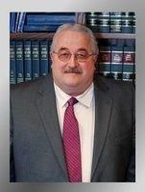
Donald “Don” Brosius
1954 - 2018
Obituary

Slide 5
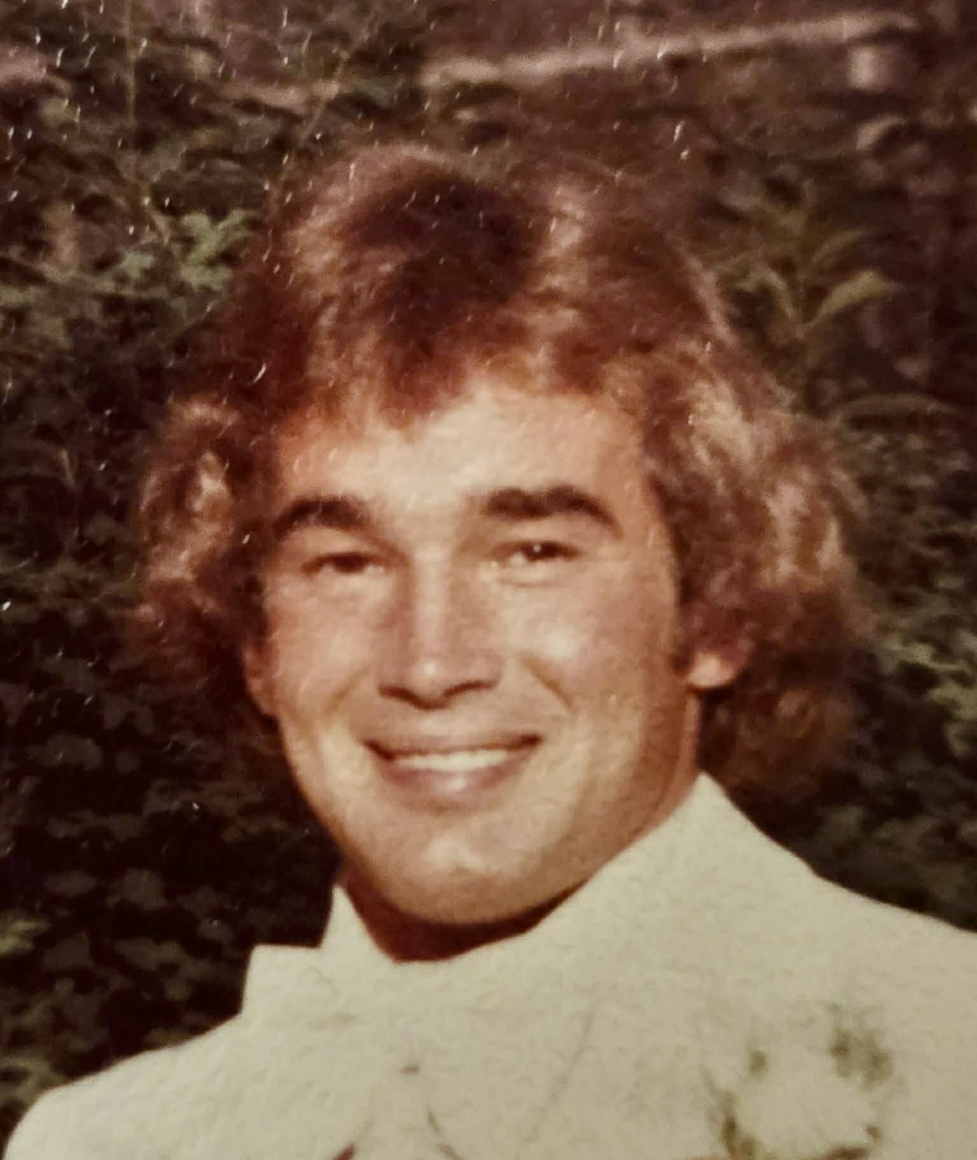
Terry Christopher
1954 - 1991
Obituary

Slide 6
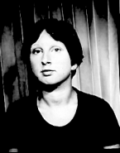
Miriam Khelghatian Coberly
1953 - 2019
Obituary

Slide 7
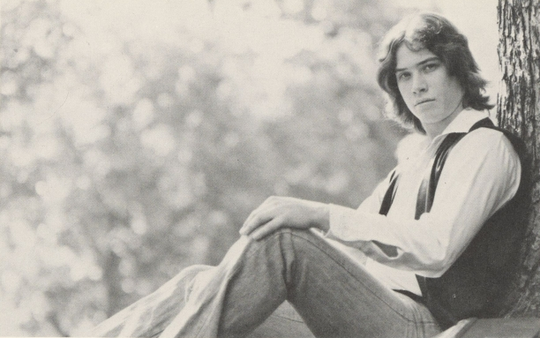
Jack Conlon
1954 - 2010
Obituary

Slide 8
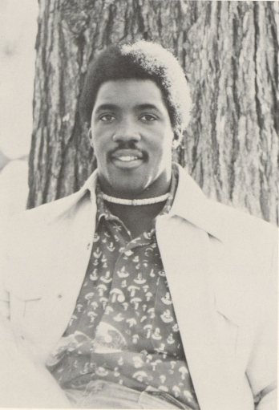
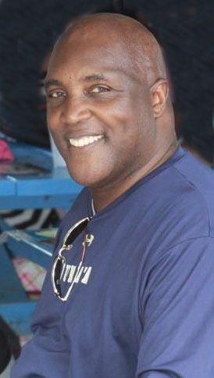
W. Stephen “Steve” Cordova
1953 - 2022
Obituary

Slide 9
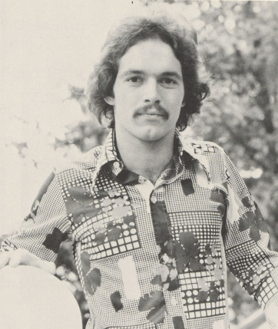
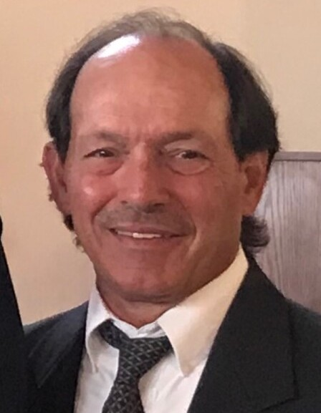
David Cortazzo
1954 - 2021
Obituary

Slide 10
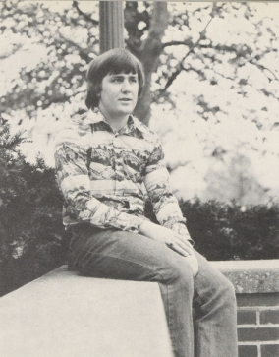
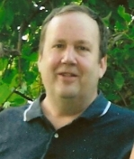
Allan Dunkleberger
1954 - 2011
Obituary

Slide 11
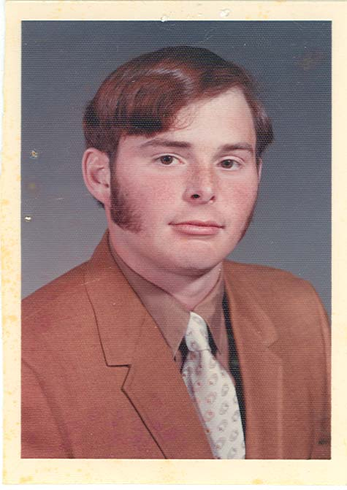
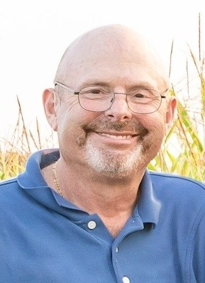
Lee Flinner
1954 - 2020
Obituary

Slide 12
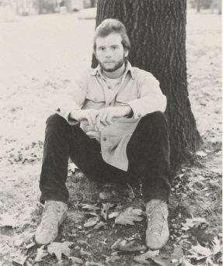
Alan Foster
1952 - 2024
Obituary

Slide 13
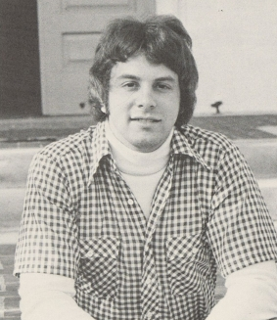
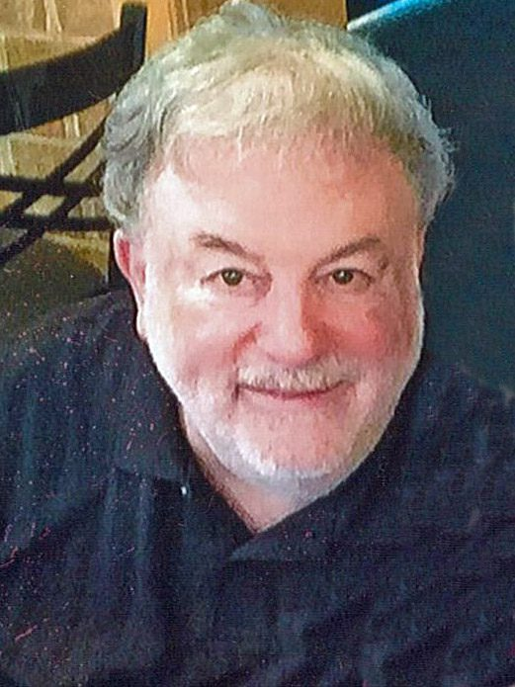
Roger Garber
1953 - 2023
Obituary

Slide 14
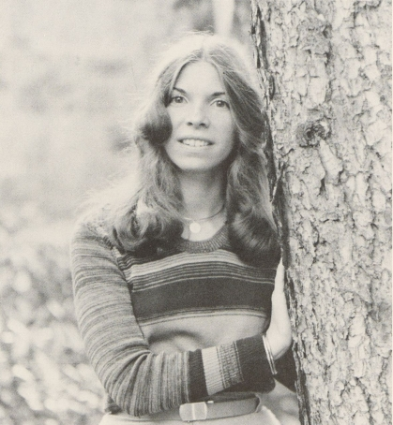
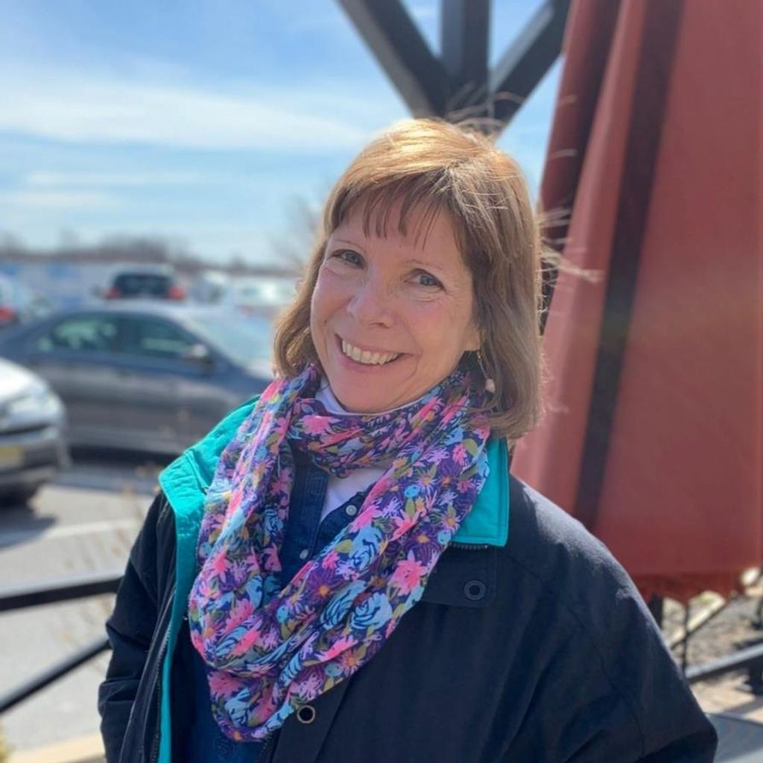
Carol (Hoover) Gardon
1954 - 2021
Obituary

Slide 15
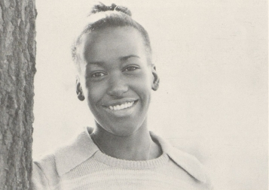
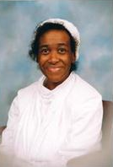
Florence Grasty-Thomas
1954 - 2013
Obituary

Slide 16
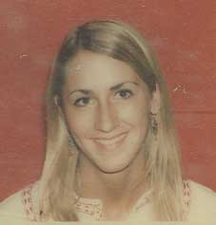
Janet Entwisle Hafer
1954 - 2012
Obituary

Slide 17

Michael Humphrey
1955 - 2010
Obituary

Slide 18
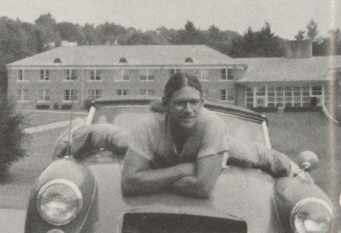
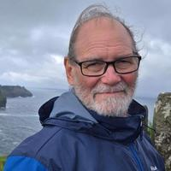
Steven “Steve” james
1954 - 2025
Obituary

Slide 19
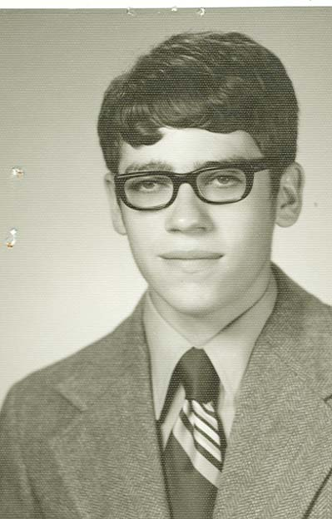
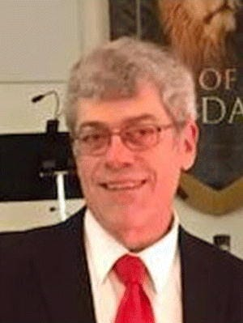
Thomas Knepper
1954 - 2021
Obituary

Slide 20
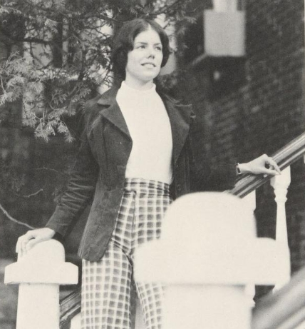
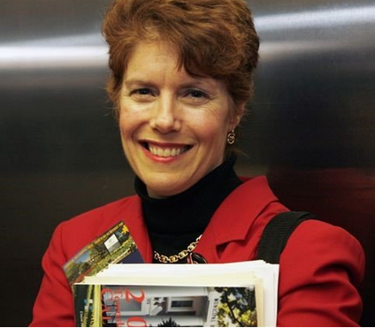
Petra (Theodos) Knox
1954 - 2019
Obituary

Slide 21
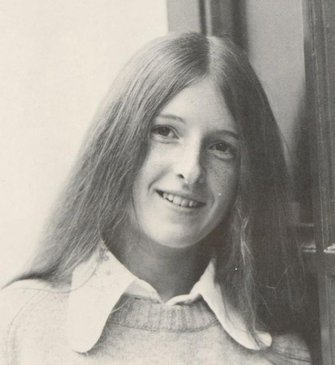
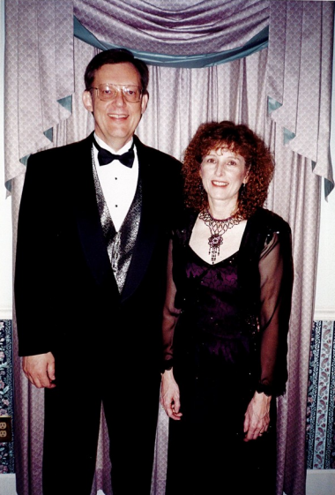
Deborah (Wilbur) Kuehn
1954 - 2002
Obituary

Slide 22
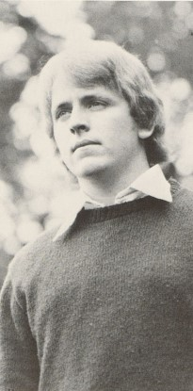
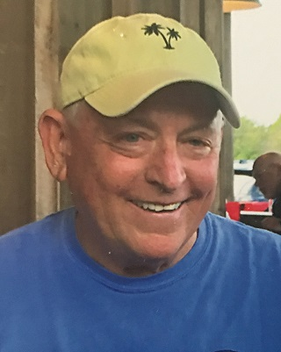
Richard “Tom” Metz
1952 - 2019
Obituary

Slide 23
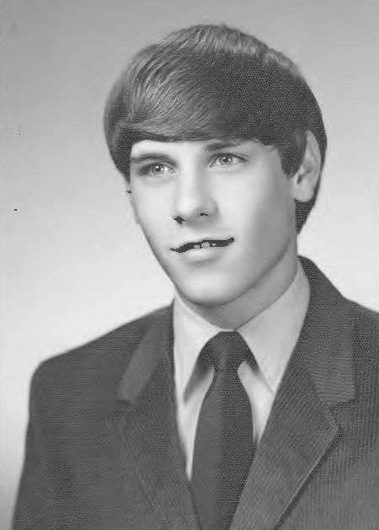
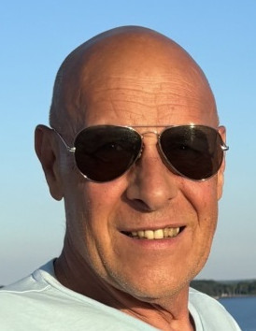
Blaise Michaels
1954 - 2026
Obituary

Slide 24
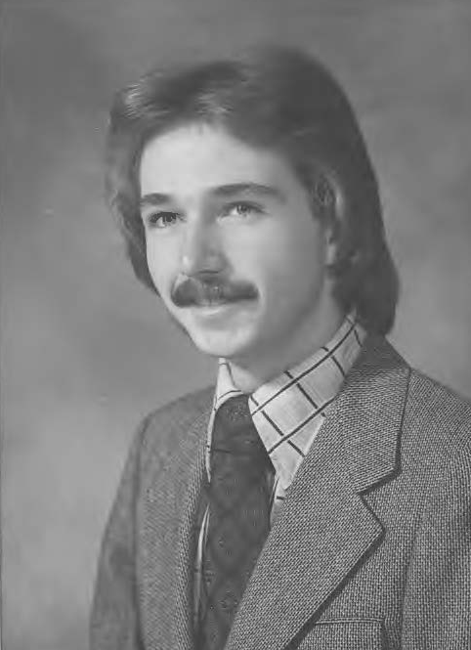
Ronald “Ron” Mowen, JR.
1954 - 1996
Obituary

Slide 25
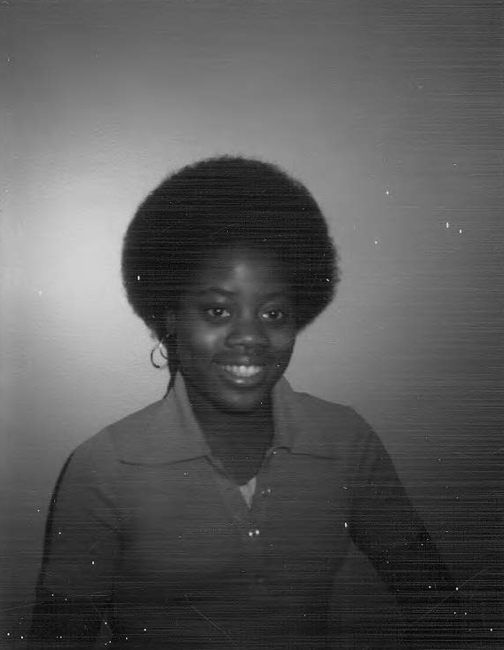
Patricia A. Neal
1954 - 1982

Slide 26
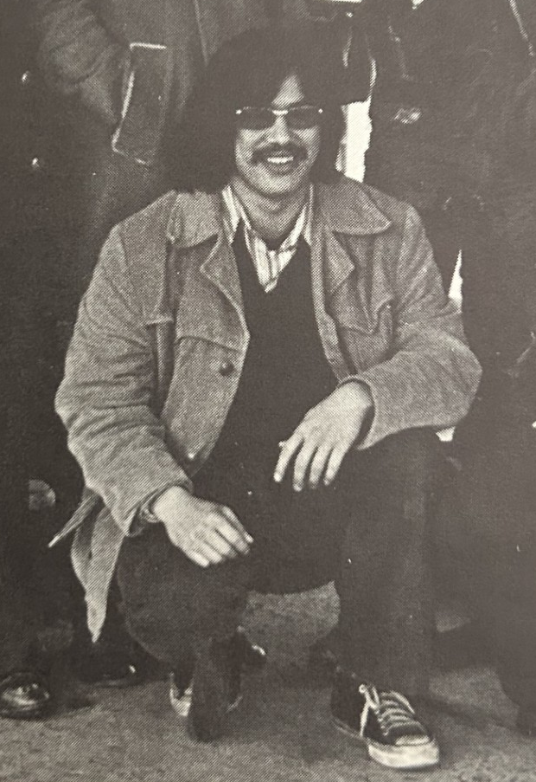
Stephen Nishiyama
1954 - 2019
Obituary

Slide 27
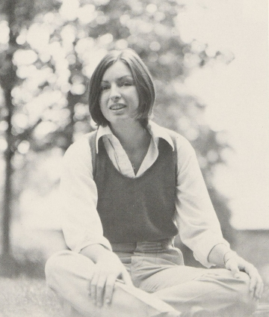
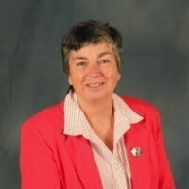
Noreen O’Connell
1954 - 2023
Obituary

Slide 28
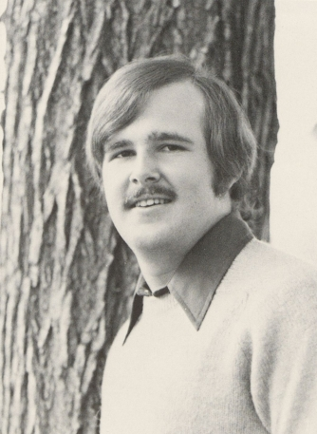
Thomas Price
1954 - 2003
Obituary

Slide 29
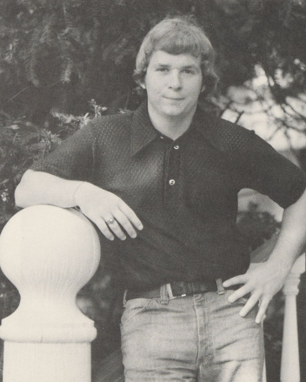
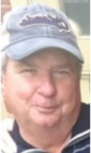
John Shuck
1954 - 2021
Obituary

Slide 30
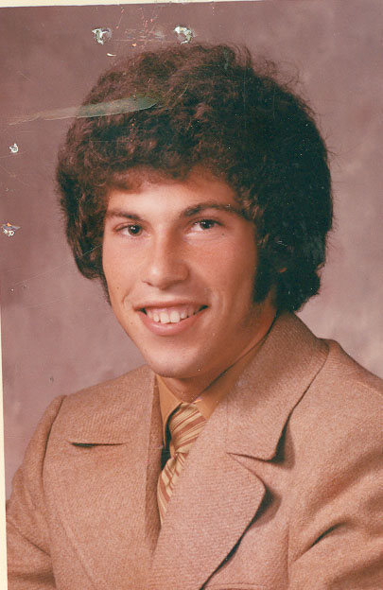
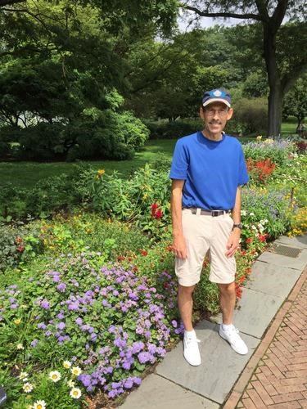
Lewis Silver
1954 - 2025
Obituary

Slide 31
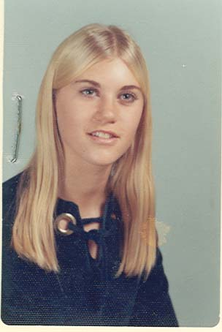
Linda (Keech) Sosna
1954 - 2014
Obituary

Slide 32
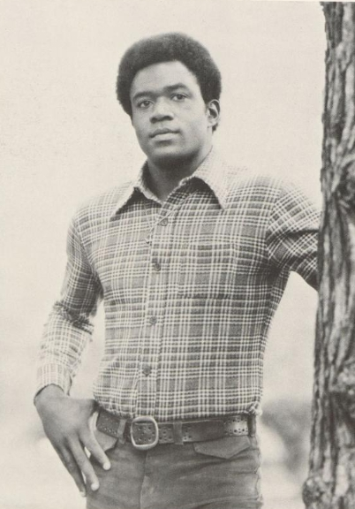
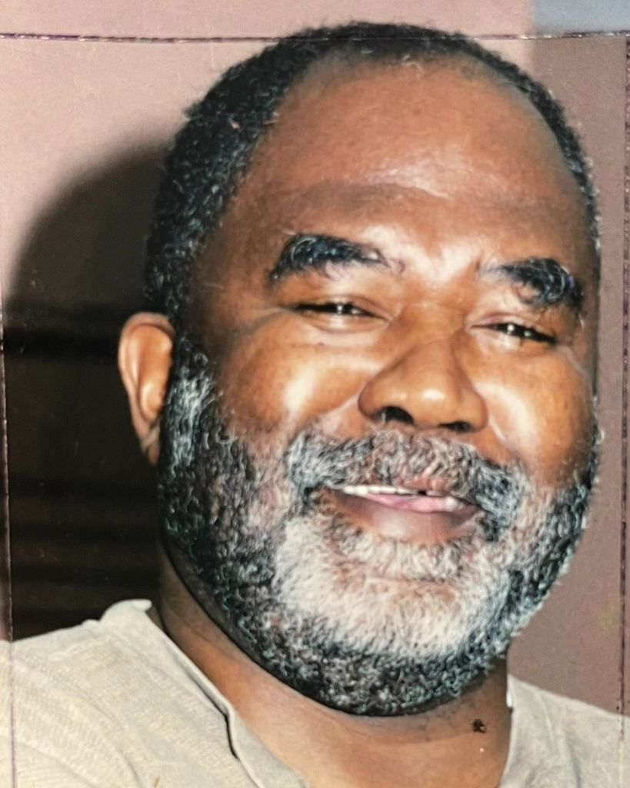
Timothy Tabor
1953 - 2023
Obituary

Slide 33
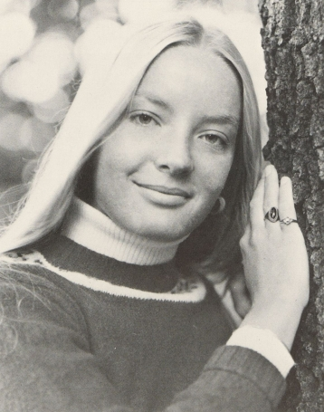

Gretchen (Sencindiver) Vare
1954 - 2014
Obituary

Slide 34


Charles Weatherby
1954 - 2023
Obituary

Slide 35

Kevin Weir
1953 - 2024
Obituary

Slide 36

Barbara “Barb” (Kosik) Whitaker
1954 - 2011
Obituary

Slide 37

Lorraine Widdowson
1954 - 2021
Obituary

Slide 38


Donald “Don” Williams
1954 - 2021
Obituary

