Slide 1
Employee Tuition Benefits for College Enrollment
Sponsored by Human Resources & Financial Planning

Slide 2
Eligibility for Benefit
JC Policy can be found at: https://www.juniata.edu/offices/human-resources/benefits/tuition-exchange.php
Full time employment status
Years of service
Different from Admission process
Most Study Abroad programs excluded
Dependent status as defined by IRS
May request copy of federal tax return starting in tax year prior to benefit start

Slide 3
Types of Benefits
Juniata Tuition Benefit
https://services2.juniata.edu/hr/tuition/index.php
Part time or Full time
Tuition Exchange
https://www.tuitionexchange.org/

Slide 4
Juniata Tuition Benefit
Online Form (must be connected to JC network) https://services2.juniata.edu/hr/tuition/index.php
Part time – apply each semester
Full time: Apply by Dec. 15th
Fees not included
Cost for Study Abroad
Contact Tracie Patrick in Fin. Planning

Slide 5
Tuition Exchange Program
Apply early to have a better chance of receiving the benefit!!
Recommended before Dec. 15th of Senior year of high school but check online to see what each school’s deadline is.
How to apply---Online Form:
https://telo.tuitionexchange.org/apply.cfm
Award not guaranteed
Decided by “import” institution
Value is determined by “import”

Slide 6
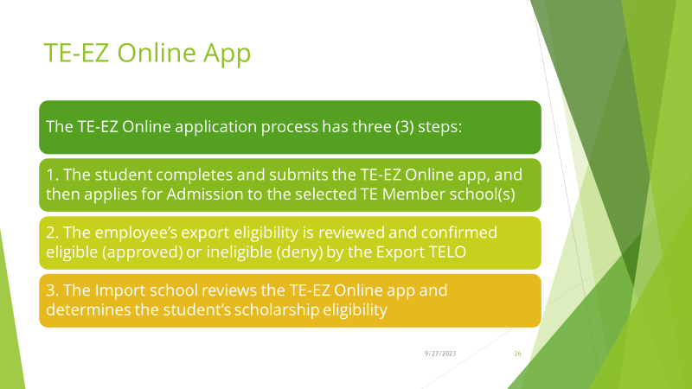
Tuition Exchange Program

Slide 7
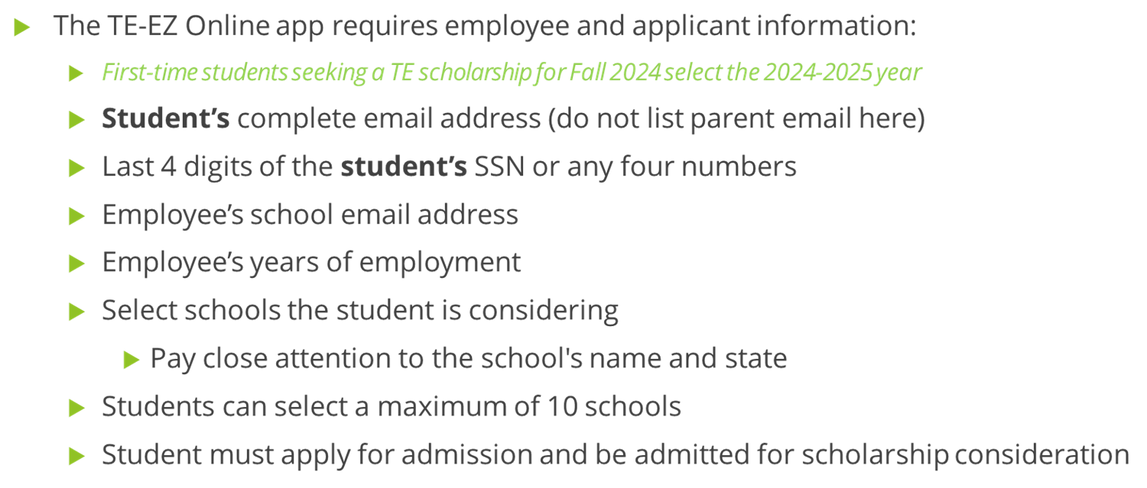
Tuition Exchange Program

Slide 8
Tuition Exchange Program

Slide 9
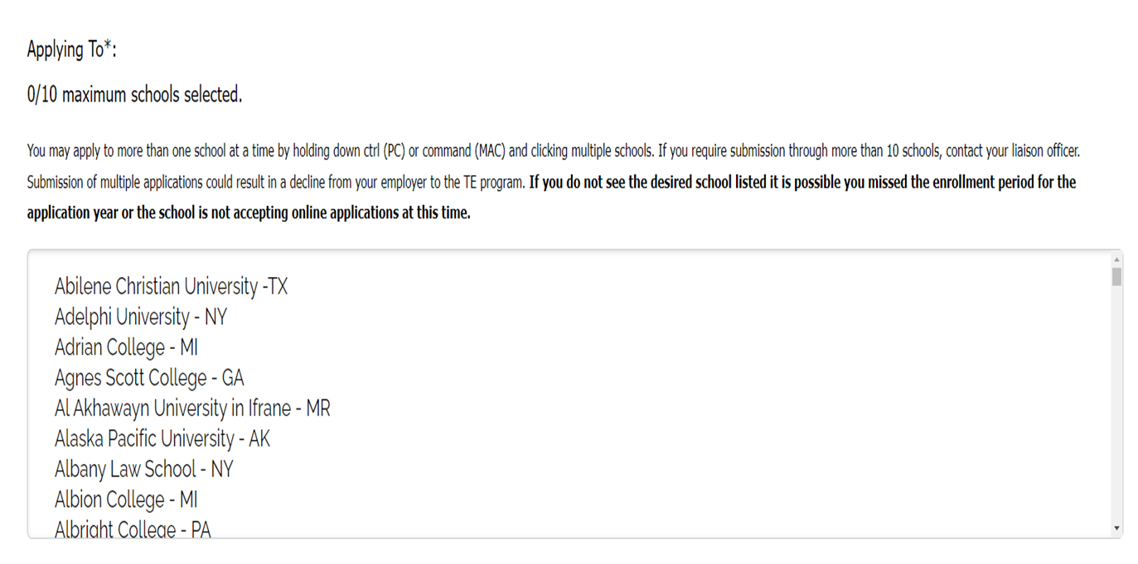
Tuition Exchange Program

Slide 10
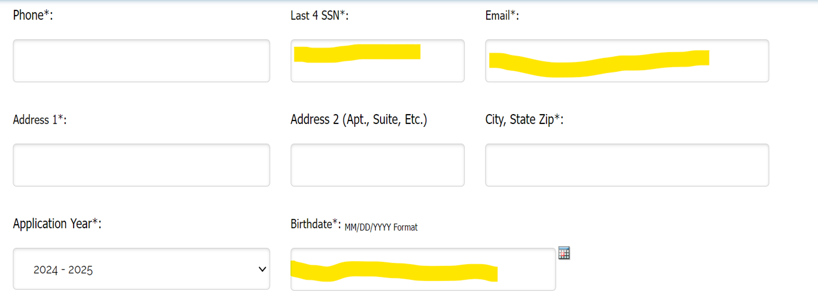
Tuition Exchange Program

Slide 11
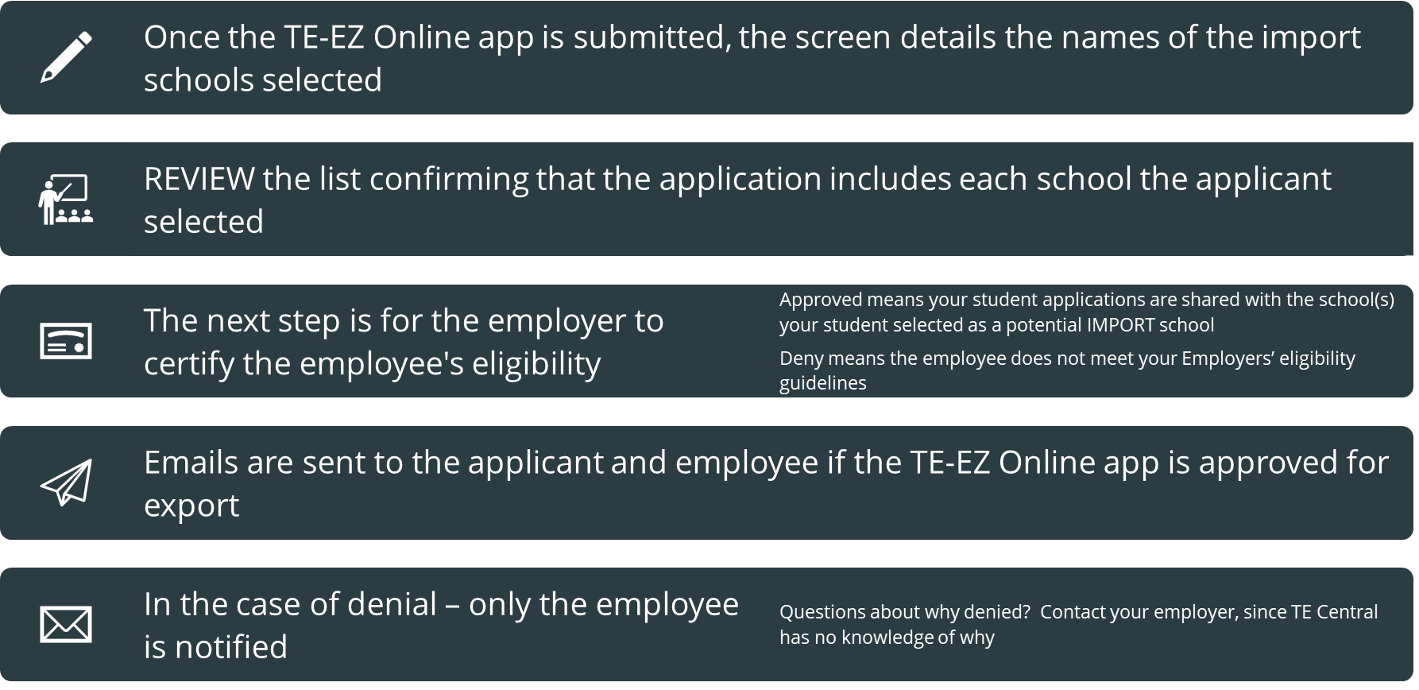
Tuition Exchange Program

