Slide 1
Assistance in the Education of Employees and Dependents
Sponsored by Human Resources & Financial Planning

Slide 2
Eligibility for Benefit
JC Policy can be found at: https://www.juniata.edu/offices/human-resources/benefits/tuition-exchange.php
Full-time employment status
Years of service requirement
Different from Admission process
Dependent status as defined by IRS
  Federal tax return used for proof of dependency status starting in tax year prior to benefit start

Slide 3
Types of Benefits
  Juniata Tuition Benefit
  Tuition Exchange

Slide 4
Juniata Tuition Benefit
How to Apply
-Online Form:
https://services2.juniata.edu/hr/tuition-benefit/
-Must be connected to JC network
Benefit Details
-Maximum of four regular academic years up to a maximum of 128 attempted credit hours.
-Tuition only
-Fees not included
-Cost for Study Abroad
-Contact Tracie Patrick in Financial Planning
Deadlines:
-Full-time: Apply for benefit by Dec. 15th
(Part-time: apply each semester)

Slide 5
Tuition Exchange Program https://www.tuitionexchange.org/
TE Resources:
-Tuition Exchange is a reciprocal scholarship opportunity for the dependents of eligible faculty and staff at all Tuition Exchange member schools-
TE School List
-Application process online training: TE EZ-Application https://tuitionexchange.org/how-te-works/
-Families-Scholarship Award Process
How to apply:
https://tuitionexchange.org/how-to-apply/
Program Details:
-Competitive process, the value of the TE scholarship is tuition or the annual set rate. -Determined by the “import” institution and is not guaranteed
-Requirements can include filing the FAFSA annually, maintaining minimum grade point average, being enrolled fulltime, and living on campus.
-Admission decisions are made before TE decisions are announced. All first-year students are typically notified of admission notifications. TE decisions generally are announced before May 1 for first-year students.
-Apply early to have a better chance of receiving the exchange.
-Recommended before Dec. 15th of Senior year of high school
-Inquire with “import” schools about individual TE application dates & procedures.
-Students can list up to 10 schools on the EZ-App

Slide 6


Slide 7
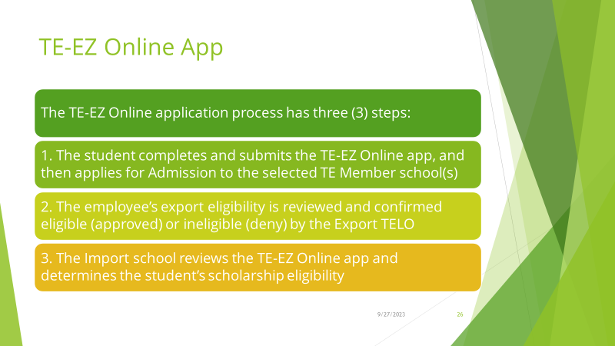
Tuition Exchange Program

Slide 8
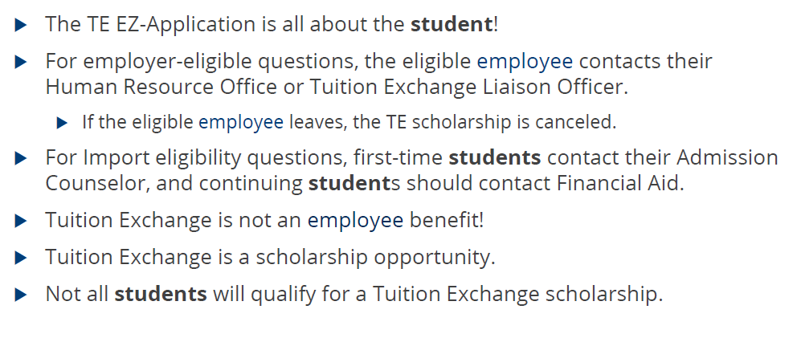
Tuition Exchange Program
TE-EZ Application Online

Slide 9
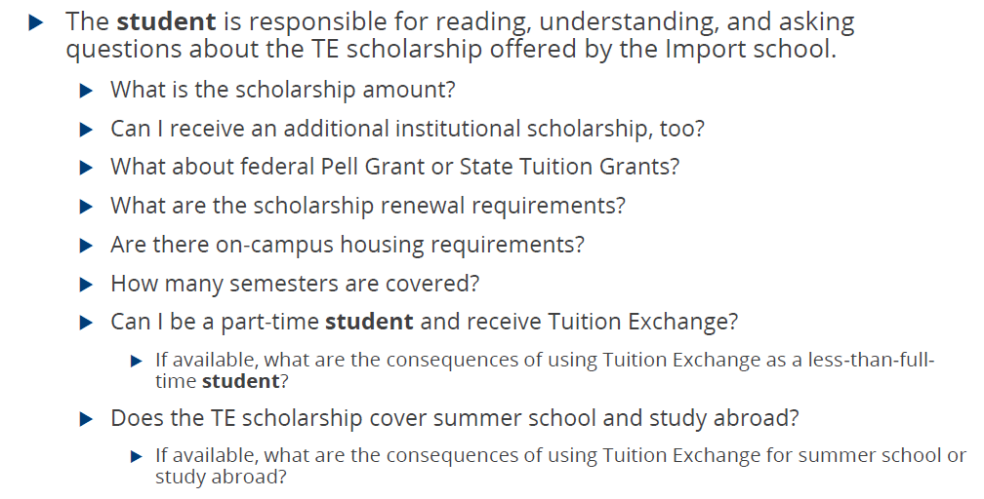
Tuition Exchange Program
Important Questions to Ask

Slide 10
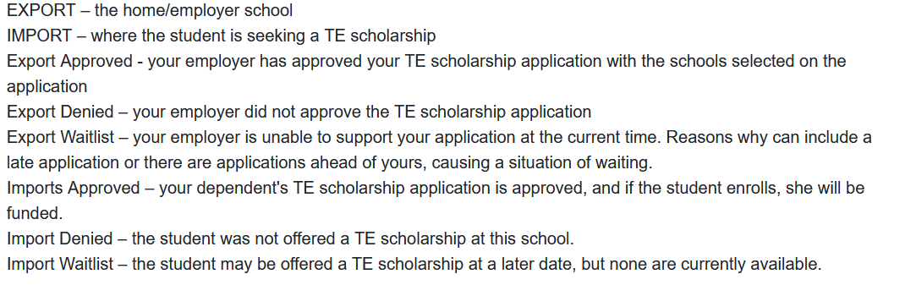
Tuition Exchange Program
Terminology

