Slide 1
Room Draw for 2021
April 1st-15th
9:00am – 5:00pm
Through Eagles Nook
Office of Campus & Residential Life
campuslife@juniata.edu
www.juniata.edu/reslife

Slide 2
The Housing Selection Process
February
March
April
Receive priority numbers
Make roommate requests
Review housing applications
Complete housing applications (you may do more than one)
Confirm roommates (minimum of 3 for multiple selection)
Multiple Selection
Single Room Selection
Double Room Selection

Slide 3
Priority Numbers
Best Priority # is 1
Anticipated graduation year
  Rising seniors (December 2020 & May 2021),
  Rising juniors (December 2021 & May 2022),
  Rising Sophomores (May 2023 & May 2024)
GPA Brackets for rising seniors and juniors
  4.0 – 3.61 / 3.60 – 3.26 / 3.25 – 2.82 / 2.81 & below
Lottery
  Lottery within GPA groups for rising seniors and juniors
  Just lottery for all rising sophomores

Slide 4
Selection #1: Multiples (3 or More) April 1st-2nd
A Group Priority number will be generated, based on the average of individual priority numbers. This group priority number will be used to determine selection order for multiple housing.
Criteria: Must have at least 2 roommate matches. All Roommates must select and confirm each other.
Examples of Multiples:
  East Suites: 8 person and 4 person
  Pink 3- person apartments
  Triple and Quad rooms in South, Cloister, Lesher
  *See complete list online:

Slide 5
Selection #2 : Single Rooms
April 7th-8th
Individual Priority numbers will be used to draw a single room or Nathan suite.
Criteria:
  Must complete the single room housing application.
  Must has one roommate to draw for a Nathan suite.
Examples of Single Rooms:
  All Nathan rooms
  Nathan suites and connecting rooms
  Cloister (4 rooms)
  Lesher (1 room)
  Please note all single rooms have a higher room rate.

Slide 6
Selection #3: Double Rooms
April 9th-15th
Within a pair, the best individual priority number will used to determine the order for room selection.
Criteria: All Roommates must be confirmed beforehand.
Examples of Rooms Available:
  All two person apartments in Hess and Pink
  All two person rooms in Cloister, Lesher, South, and Tussey Terrace
  Any remaining spaces
  All unhoused students will automatically be assigned to Double Room Selection, including students who do not have roommates.

Slide 7
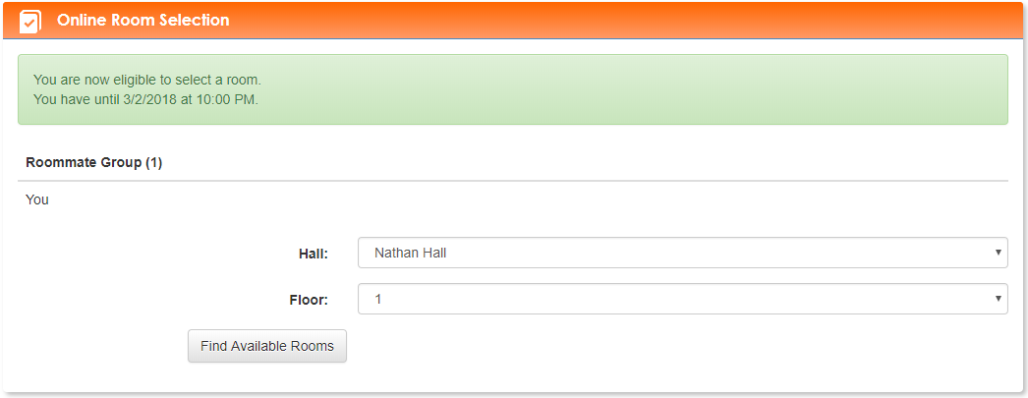
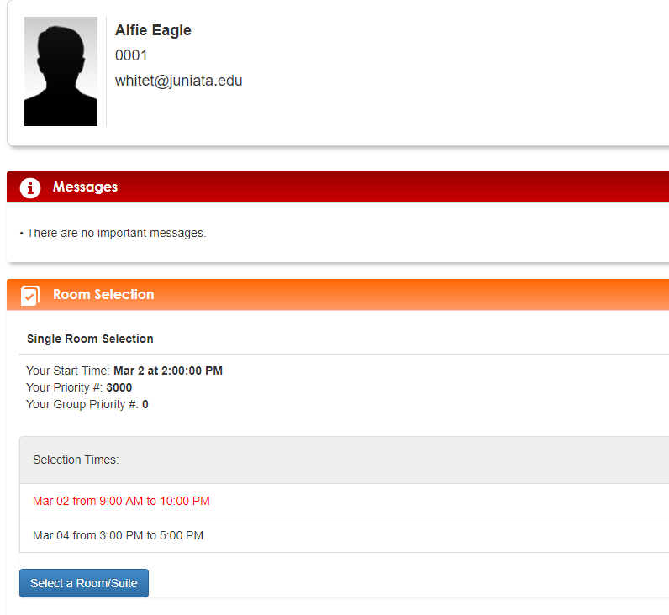
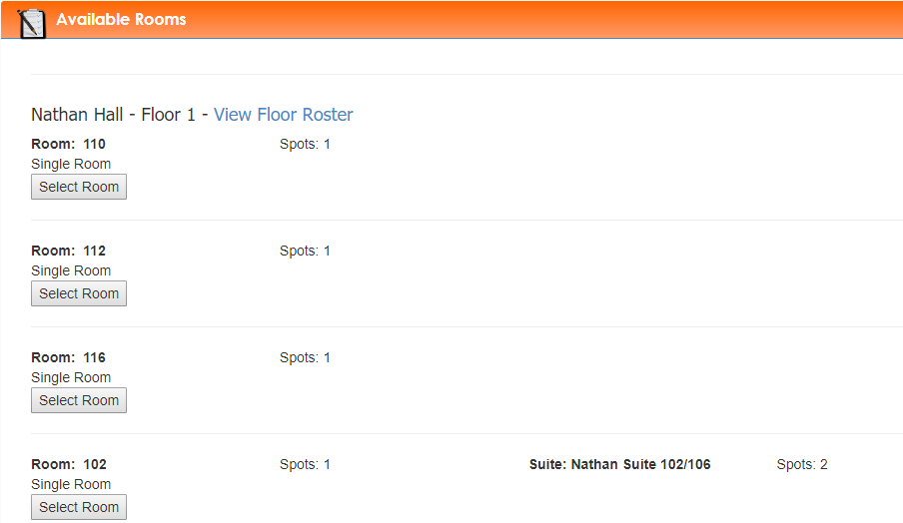
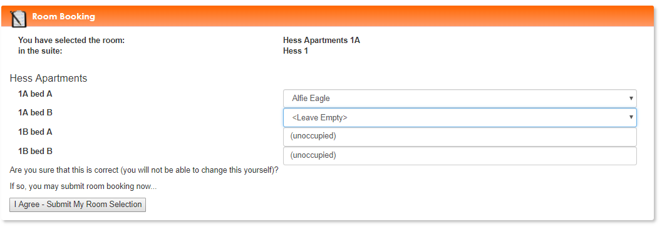
Sample Room Selection

Slide 8
Looking for a Roommate?!
Here are your options:
Search for a roommate on
Eagles Nook
Applying for an international roommate through the Eagles Nook.

Slide 9
Things to do before
Room Draw…
  Complete your preferred housing applications by TBD.
  Request and confirm all roommates by March 13th .
  Check your selection start time.
  (sent to Juniata email and on your Eagles Nook account)
  Designate one person to select housing for your group or pair.
  Set an alarm for your selection time.
  (Note: you will have 5-10 minutes before the next group or person can select housing)
  Review the confirmation email to make sure everything is accurate.
  Once you participate in one selection process, you will be removed from the other processes.

Slide 10
Room Draw FAQs
Are the Nathan suites part of single room or double room selection?
  Single

Slide 11


