Slide 1
Housing Selection 2018
April 9 – 20
9:00am – 5:00pm
Through Eagles Nook
Office of Residential Life
residentiallife@juniata.edu
www.juniata.edu/reslife

Slide 2
Priority Numbers
Best Priority # is 1
Anticipated graduation year
  Rising seniors (December 2018 & May 2019),
  Rising juniors (December 2019 & May 2020),
  Rising Sophomores (May 2021 & May 2022)
Lottery
  Lottery within GPA groups for rising seniors and juniors
  Just lottery for all rising sophomores
GPA Brackets for rising seniors and juniors
  4.0 – 3.56 / 3.55 – 3.17 / 3.16 – 2.7 / 2.69 & below

Slide 3
Selection #1: Multiples (3 or More)
April 9 - 12
A Group Priority number will be generated, based on the average of individual priority numbers. This group priority number will be used to determine selection order for multiple housing.
East Suites: 8 person and 4 person
  Double rooms
  Shared living room and bathroom
  Air conditioned
Houses and apartments:
  Buildings: Mission, Pink, Hess, 2111, 305 College Ave, 614, 1731, 1815, 1931
  All have shared kitchen, living room and bathroom
Triple and Quad rooms:
  Buildings: South, Cloister, Lesher, Hess
  All Roommates must select and confirm each other beforehand.

Slide 4
Selection #2 : Single Rooms
April 13 - 16
Nathan
  All Nathan rooms (including connecting singles)
Other locations with single rooms
  Lesher x 1
  Tussey x 1
  Terrace x 1
  Cloister x 4
  Pink Palace x 3
  Please note all single rooms have a higher room rate.

Slide 5
Selection #3: Double Rooms
April 17 – 20
Within a pair, the best individual priority number will used to determine the order for room selection.
Standard doubles:
  Cloister
  Lesher
  South
  Tussey Terrace
  Hess
Any remaining spaces

Slide 6
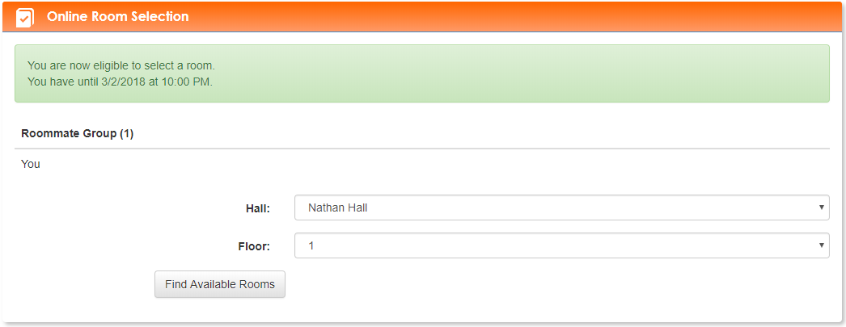
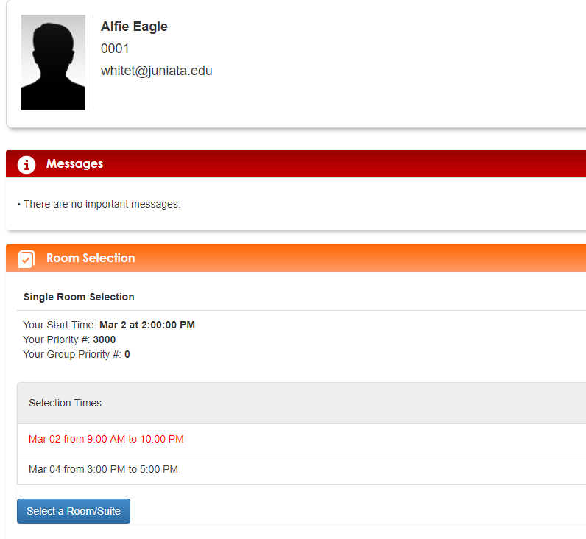
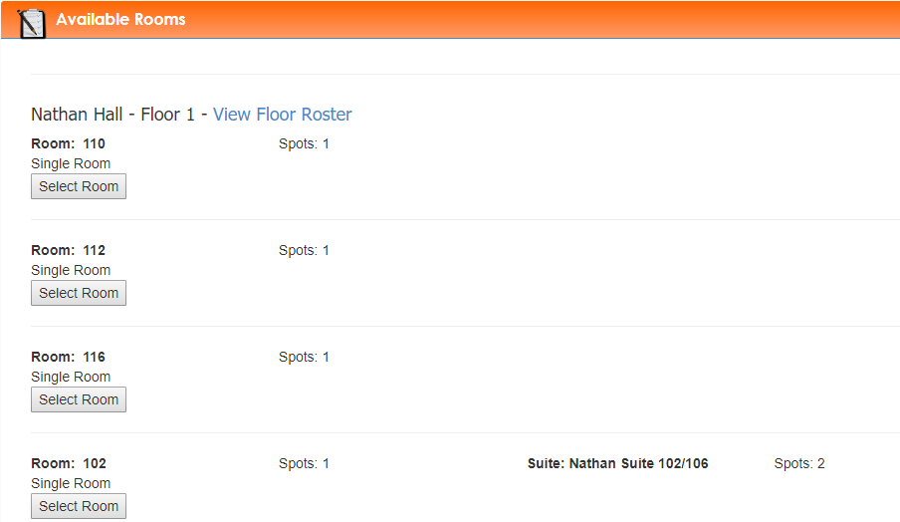
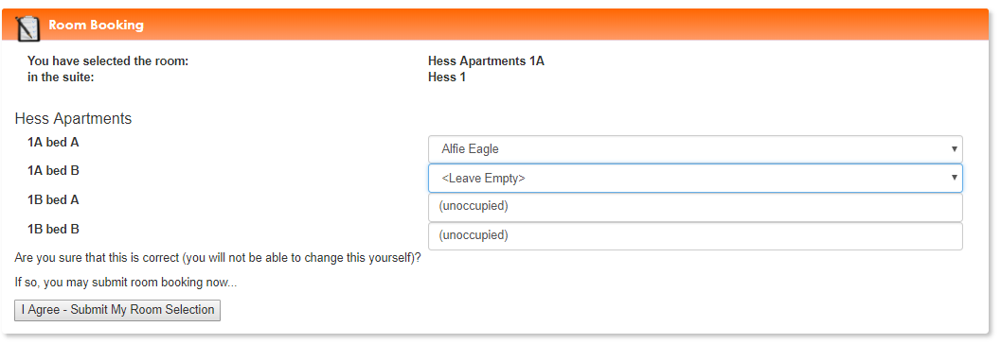
Sample Room Selection

Slide 7
Looking for a Roommate?!
Come to our Roommate Mixer
March 29 at 7 PM & April 4 at 9 PM
in Neff Hall, VLB.
Search for a roommate on
Eagles Nook
Applying for an international roommate through the Eagles Nook.

Slide 8
Things to do before Room Draw
  Complete the housing application by April 5.
  Request and confirm all roommates by April 5.
  Check your selection start time.
  Designate one person to select housing for your group or pair.
  Set an alarm for your selection time.
  (Note: you will have 10 minutes before the next group or person can select housing)
  Review the confirmation email to make sure everything is accurate.
  Once you participate in one selection, you will be removed from the others.

Slide 9


