Slide 1
Room Draw 2016
April 10th, 11^{th &} 13th
Ellis Ballroom @ 8pm
Office of Residential Life
residentiallife@juniata.edu
www.juniata.edu/reslife

Slide 2
Priority Numbers
Highest Priority # is 1
Anticipated graduation year
  Rising seniors (all GPA groups),
  Rising juniors (all GPA groups),
  Rising Sophomores
GPA Groups (rising seniors and juniors only)
  4.0 – 3.3 / 3.29 – 2.67 / 2.66 – 2.0 / 1.99 & below
Lottery
  Lottery within GPA groups for rising seniors and juniors
  Straight lottery for all rising sophomores

Slide 3
Day 1: April 10th, 8 pm
East Suites & Singles
East Suites: 8 person and 4 person
  Double rooms
  Shared living room and bathroom
Singles:
  75 singles in Nathan Hall
  Approximately 24 singles in current residence halls
  Additional cost for all singles

Slide 4
Day 2: April 11th, 8 pm
Priority #s 1-500
Standard doubles:
  Cloister, Lesher, South, Terrace, and Tussey
Multiples:
  Triples, Quads, Houses, and Apartments
  List of multiples available on the Room Draw website

Slide 5
Day 3: April 13th, 8 pm
Priority #s 500 +
Remaining standard doubles:
  Cloister, Lesher, South, Terrace, and Tussey
Remaining rooms/multiples:
  Singles and East Suites
  Triples, Quads, Quints, Houses, and Apartments

Slide 6
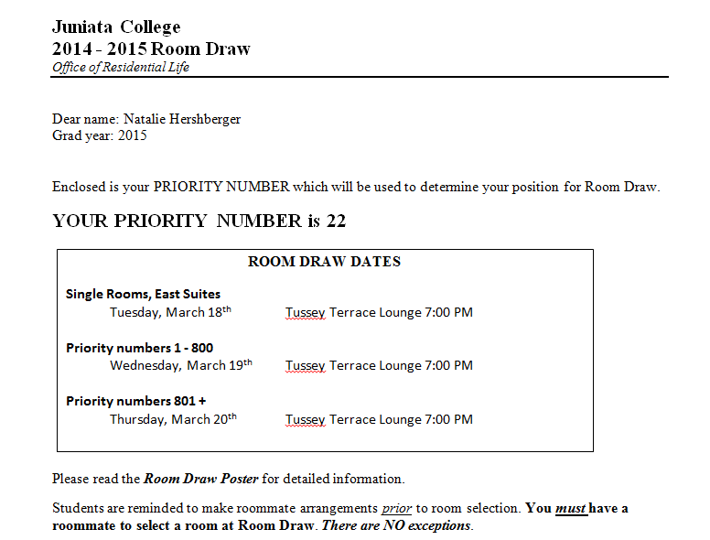
Sample Room
Draw Letter

Slide 7
Proxy Form
You only need a Proxy Form if the person with the best lottery number cannot be present at Room Draw.
Your proxy MUST bring this signed form to Room Draw along with their Juniata ID and BOTH Room Draw Letters or they will NOT be permitted to participate in Room Draw on your behalf.
Form can be found under “Room Draw” tab on the website
Room Draw Letters for those individuals who are studying abroad can be picked up in the Residential Life office

Slide 8
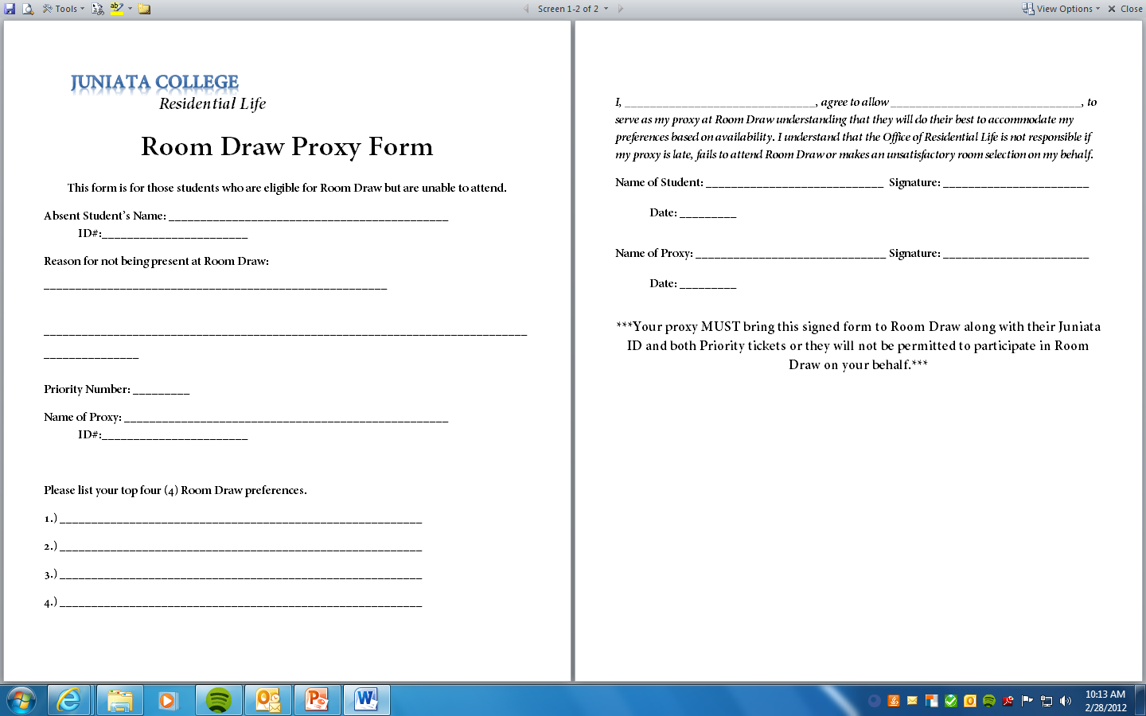

Slide 9
Looking for a Roommate?!
Come to our info session on Monday, April 4th at 9pm in Sill Boardroom or consider applying for an international roommate.

Slide 10


