Slide 1
RSO Presidents & Treasurers Training
2016-2017

Slide 2
Welcome
Please Sign In
  Indicate if you are interested in Allocation Board or RSO Approval Board (more info to come)
    Don’t know what that is? Do not worry! We’ll follow up.
Binders
  Returning RSOs – Grab Your Binder
  Returning RSOs with No Binder - It’s in your possession
  New RSOs – Get a New Binder

Slide 3
Introductions
Erin Paschal - Director of Student Engagement and Campus Activities
Brett Greene – Resident Director/Assistant Director of Campus Activities
Stephanie Meyers – Customer Service and Information Desk Representative
Betty McKim - Accounting Assistant
Erika Slocum – Account Payable Specialist
Nathan Kohl Wyatt – Student Government Vice President
Annie Small – Student Government Treasurer

Slide 4
Office Locations
SECA
  2nd Floor Ellis Hall, across from Eagle’s Landing
  10am – 7pm, M - F
Information Desk/Bursar’s Counter
  Main Floor Ellis
  Info Desk: 8:30am – 8pm
  Bursar’s Counter: 10am – 3pm
Accounting Office
  IH Brumbaugh House (17th)
  8:30am – 4pm

Slide 5
Training Agenda
Binders
RSO Overview
Event Policies and Procedures
Budget Information and Paperwork
RSO Approval Board and Allocations Board
Questions

Slide 6
Binder Overview
All RSOs Receive a Binder
RSO Handbook
Red Receipts Folder
Pocket Pouch for Receipts/Fundraisers/Etc.
P-Card Due Dates
Account Number and Starting Balance for Year

Slide 7
RSO Overview
What is an RSO?
Who Can be in an RSO?
Officer Positions and Responsibilities
General Membership
CIS Group
Re-registration Process
Office Supplies
Notes:
CIS – advocacy, arts, club sports, communication & programming, cultural, outdoors, science, service, spiritual organization

Slide 8
Event Policies and Procedures
General Event Planning
  Event Registration Form
  Sodexo Catering
BYOB Events
  2 weeks prior to event
  Event Manager
  Exceptions
Movie Events
  Must purchase license
Traveling Events
Fundraisers
  Ellis and Residence Halls
  Raffles & 50/50 Drawings

Slide 9
Event Policies and Procedures (cont.)
Advertising on Campus
High Risk Activities
Working with Minors
Juniata Brand Usage
Club Sports Field Scheduling

Slide 10
RSO Budgets Overview
Requesting Funding in Spring
  Petitions for Additional Funding
Current Budget Amounts and Account Code
  Account Number: 21-AAAAA-XXXX
  Object Codes:
    Expenses – 6199
    Deposits – 4829
You are responsible for maintaining your records
  Treasurer’s Report
  Keep your receipts and transaction records!

Slide 11
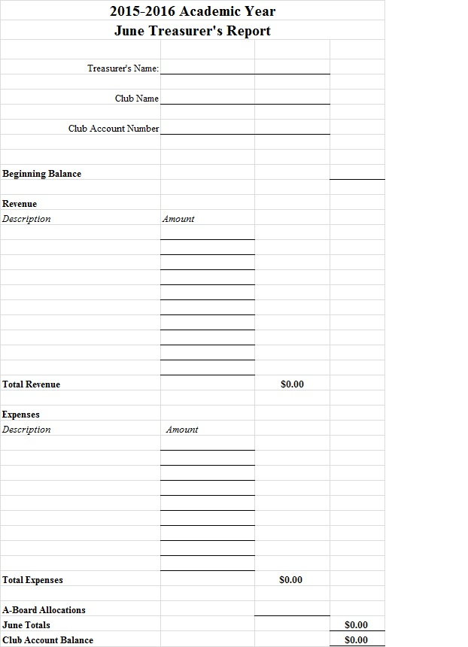
Treasurer’s Report Sample
Notes:
Might be useful to demonstrate at training
The purpose of the treasurer’s report:
Gauge how much you spend in a year
Know how much you spend on a particular item/event per year
Make estimates for how much money you will need the following year

Slide 12
Purchases
Purchasing Cards (P-Cards)
Cash Advance
Accounts Payable Form
Check Advance
Purchase Order
Reimbursement

Slide 13
Purchasing Cards (P-Cards)
Terms and Conditions
  Must have at least $800 in your RSO account
  Only the president, treasurer and/or advisor can be named on the card, and the only persons that can make purchases
  However it is the treasurer’s responsibility for ALL purchases, receipts, accurate account information, etc.
Lost Card
  Please report lost card immediately to Betty McKim; only one (1) chance to lose a card; on your second time you will lose your P-Card privileges for the remainder of the school year.

Slide 14
P-Cards (cont.)
Schedule of when P-Card Receipts are due:
  All P-Card receipts must be placed in the Treasurer folder that was given to you. All receipts must be signed by the treasurer of the club.
  All P-Card receipts are due by 12:00 p.m. on the 28th day of the month or the next business day if the 28th falls during a weekend.
    Email reminders will be sent. There should be no excuses for not having receipts turned in on time and that “you did not know” when receipts were due.
  See Handout of Schedule. DO NOT LOSE!

Slide 15
P-Card Policies
Consequences of Late Receipts/No Receipts
  1st time: Warning
  2nd time: P-Card will need to be turned into Betty McKim for the remainder of the school year.
Change in Officers
  If there is a change in officers, please email SECA at seca@juniata.edu with your updates immediately.
  If there is a change in the Treasurer position, the current Treasurer must return the visa card and grey Wal-Mart card directly to Betty McKim.
    If officers have changed and we find out otherwise, you will lose your P-Card privileges.

Slide 16
P-Card Folders
All P-card receipts need to be placed in your RED RSO Treasurer folder and placed in the black crate in SECA.
  If you did not use your P-card during the past cycle, then no receipts/folders need to be turned in to SECA.
RSO “mailbox” folders
  Treasurer Folders will be returned to your RSO folder in the black filing cabinet in SECA once the receipts have been reviewed.
  Any mail for RSOs from the Post Office will be in your RSO folder in the black filing cabinet.

Slide 17
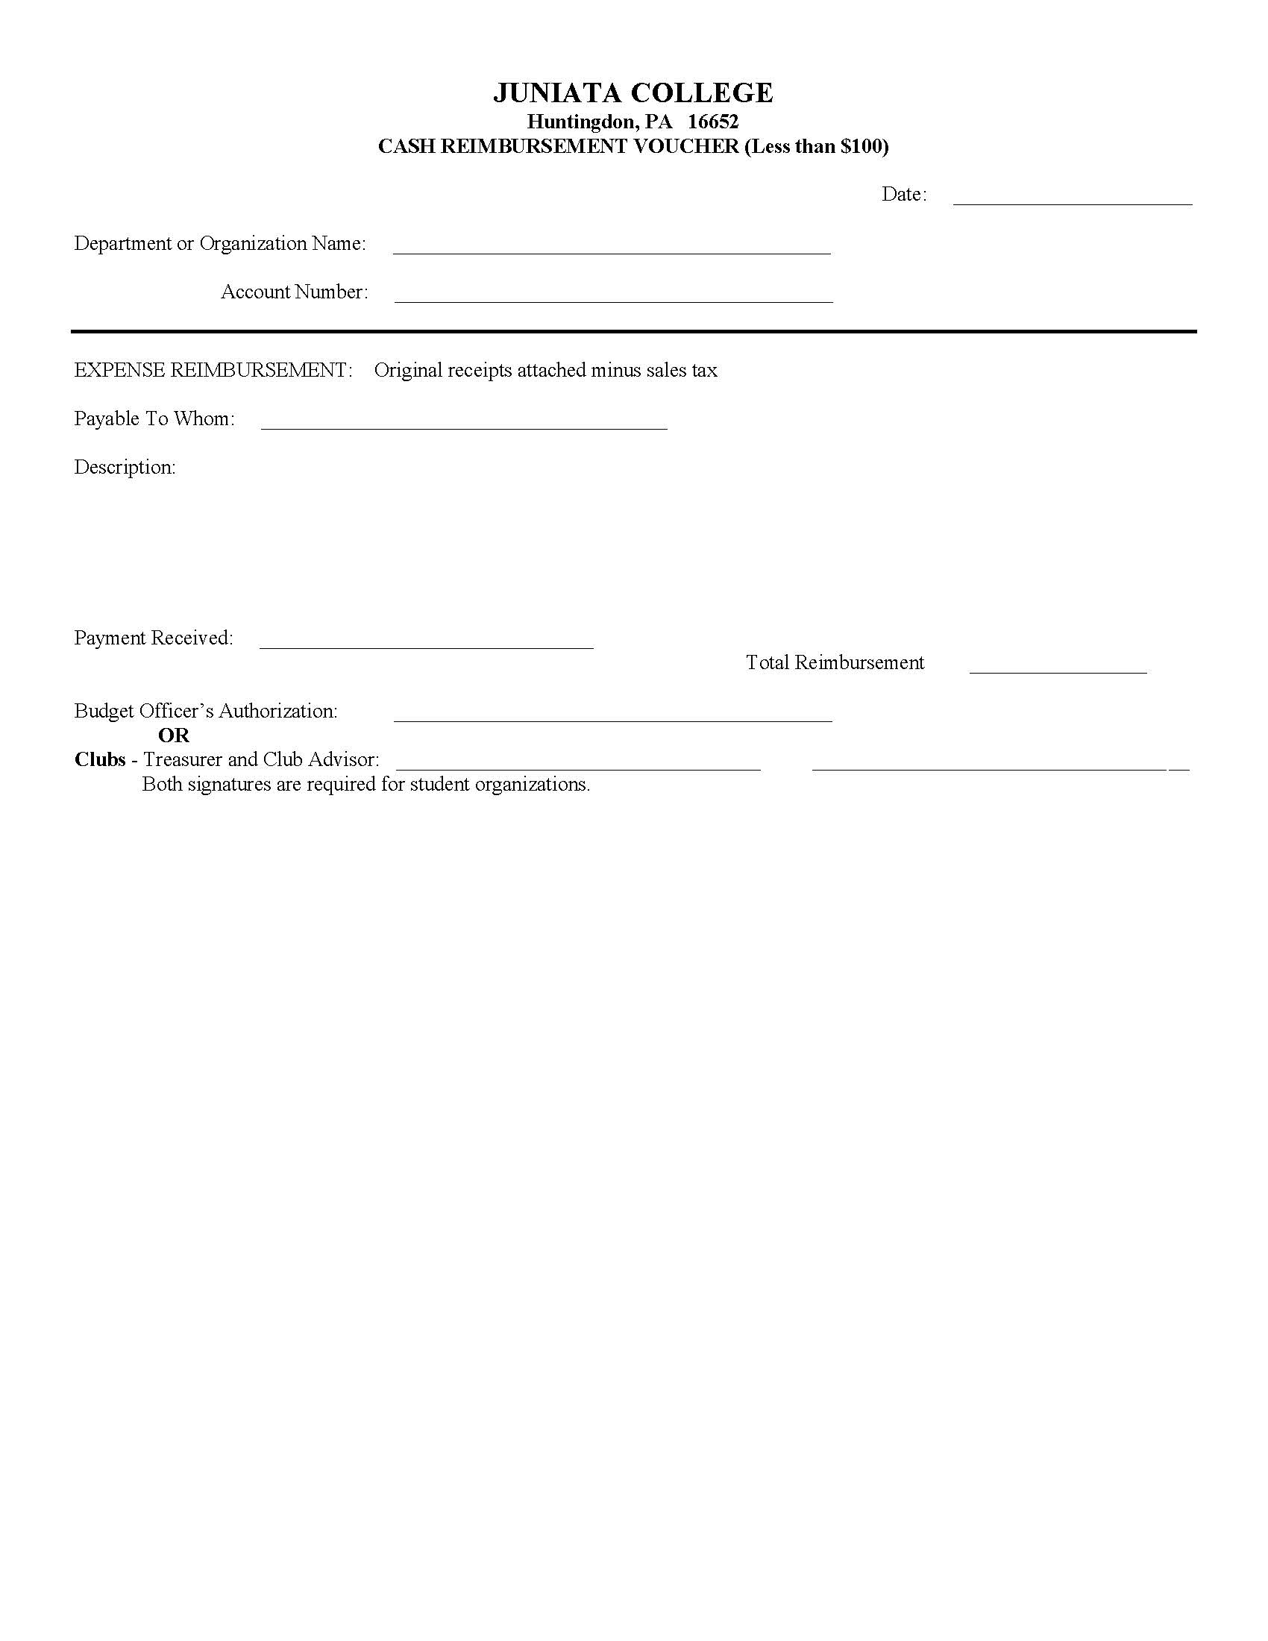
Cash Reimbursement Form
For $100 or less
You may not reimburse tax
Append the object code 6199 to your account number
  21-AAAAA-6199
Bring the form and the receipt from the purchase to the Bursar’s Office to receive the cash
Notes:
Make a copy of the receipt and the form before turning them in
Keep the slip from the bursar’s office

Slide 18
Cash Advance
Receive cash $100 or less in advance of an event/trip/purchase
Complete the Cash Advance Form
Append the object code 6199 to your account number
  21-AAAAA-6199
Bring the form to the Bursar’s Office to receive the cash
Keep the slip from the Bursar’s Office (you will need it for the cash advance clear)
You must clear the cash advance within 1 week of purchase
  Write the receipt number on the slip from the Bursar’s Office when you received the cash advance

Slide 19
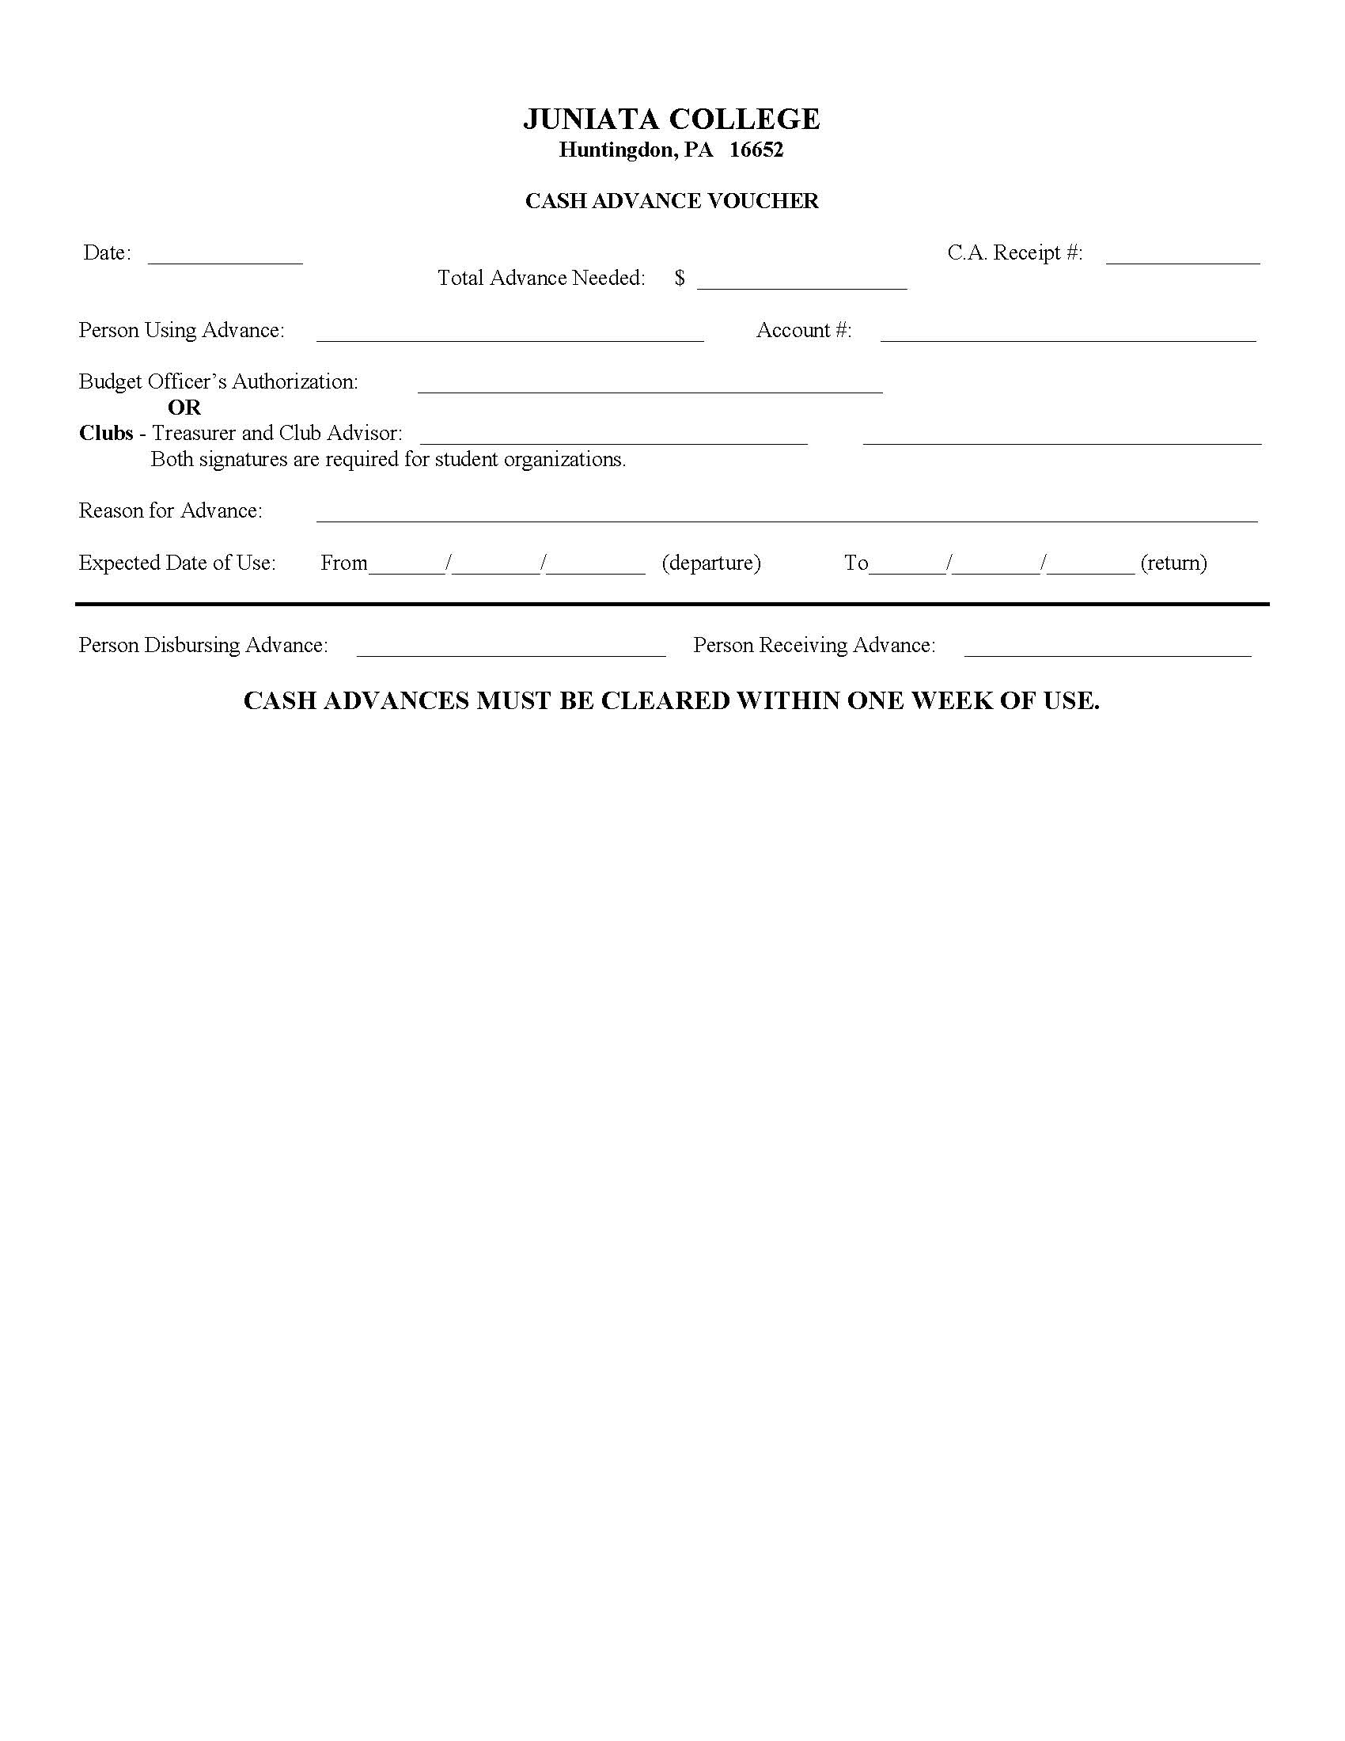
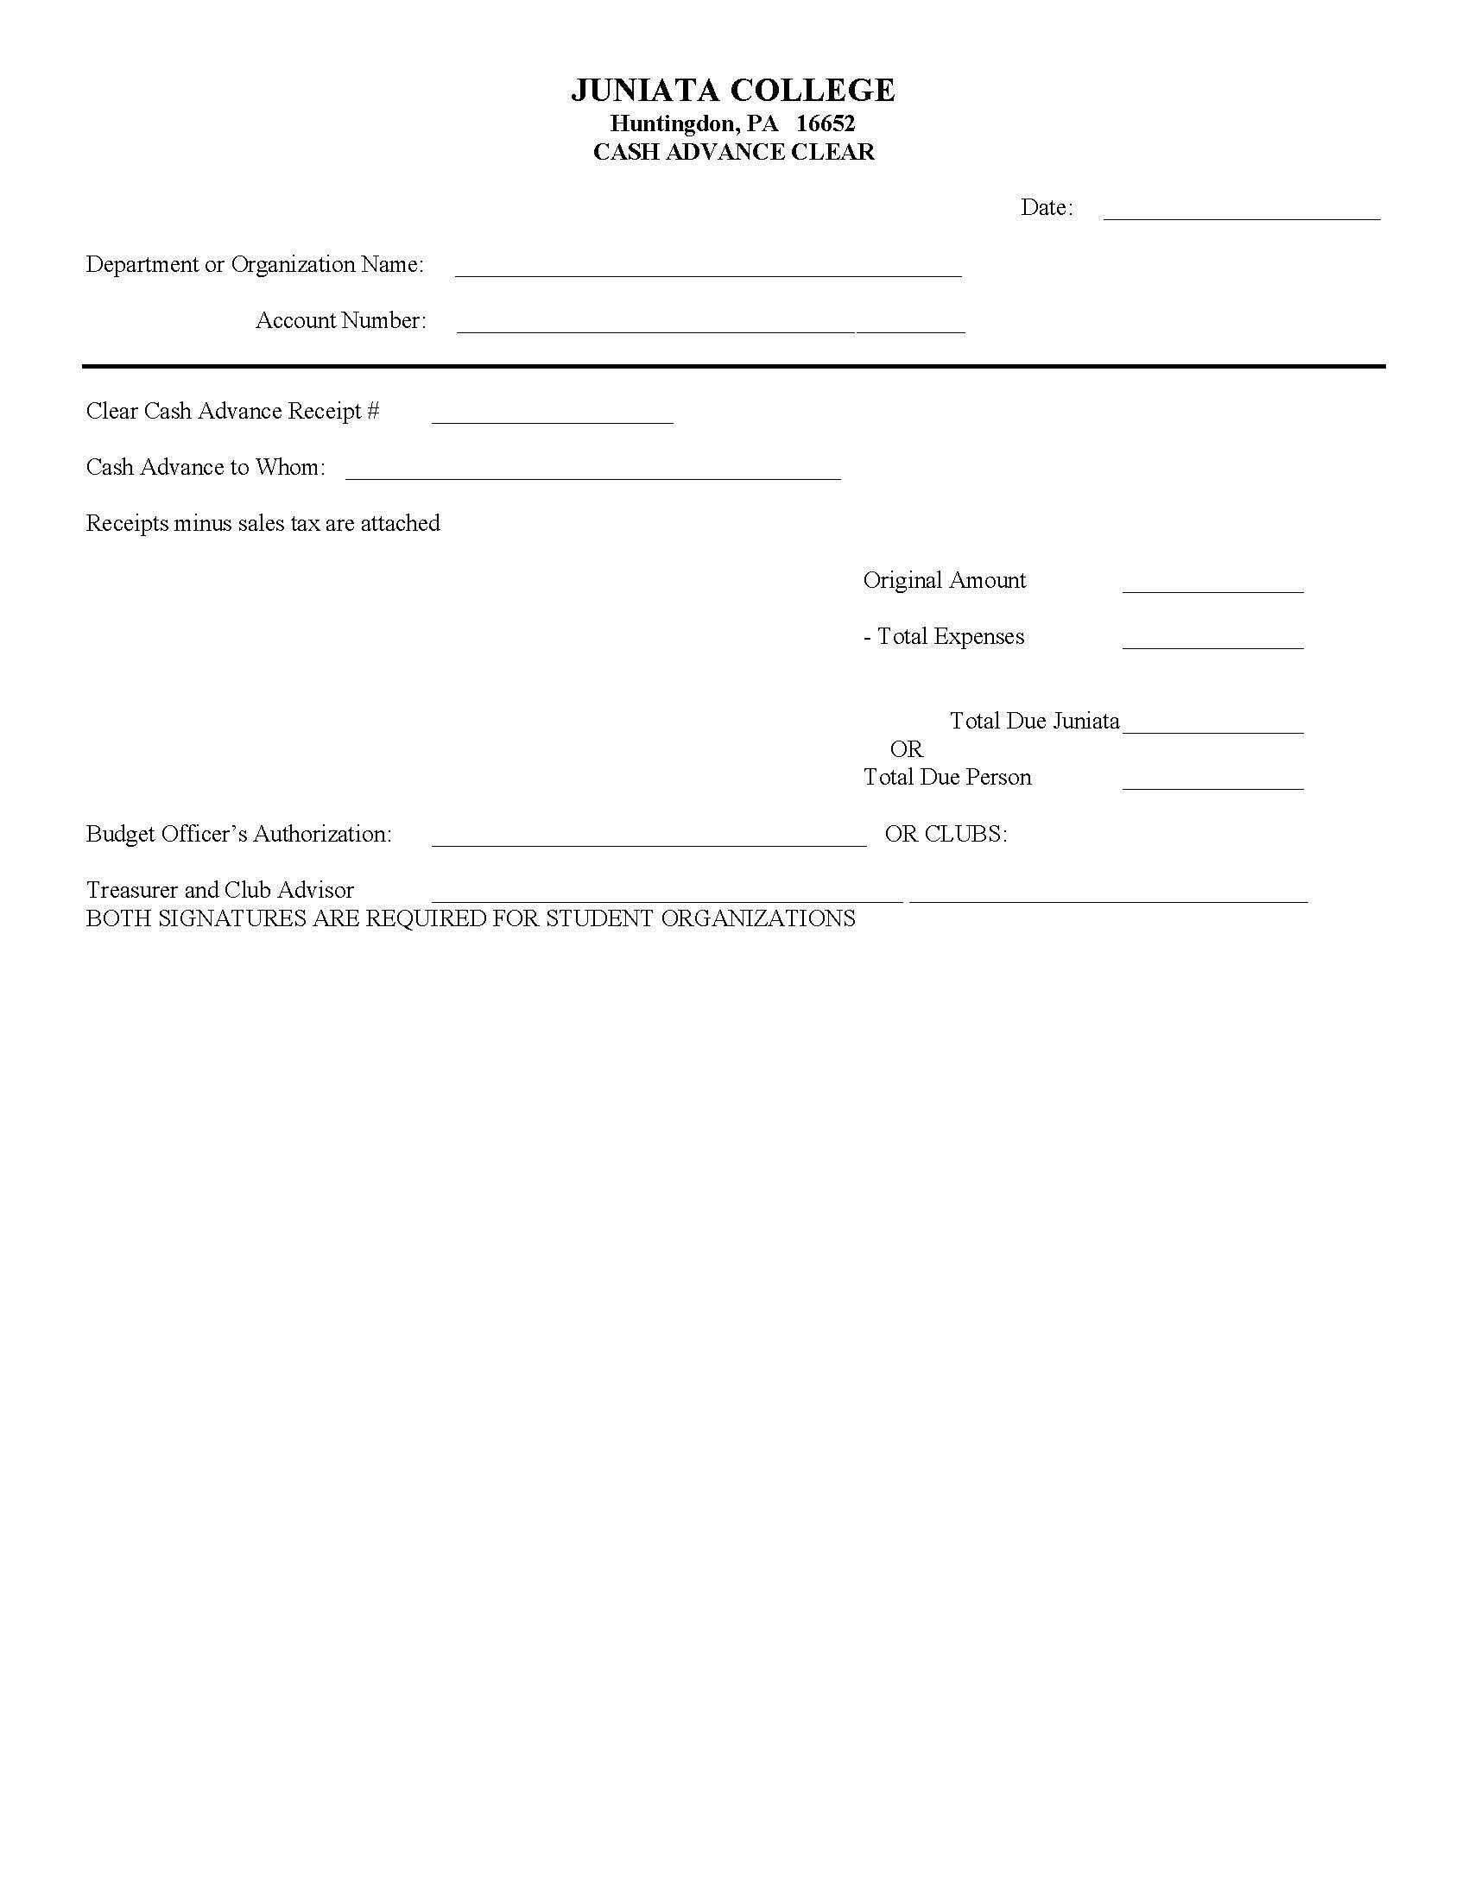
Cash Advance and Clear Forms
Notes:
If you take money out to make change for ticket sales, cash box, etc., you must “clear” all of that money and not put it in your RSO fundraiser deposit

Slide 20
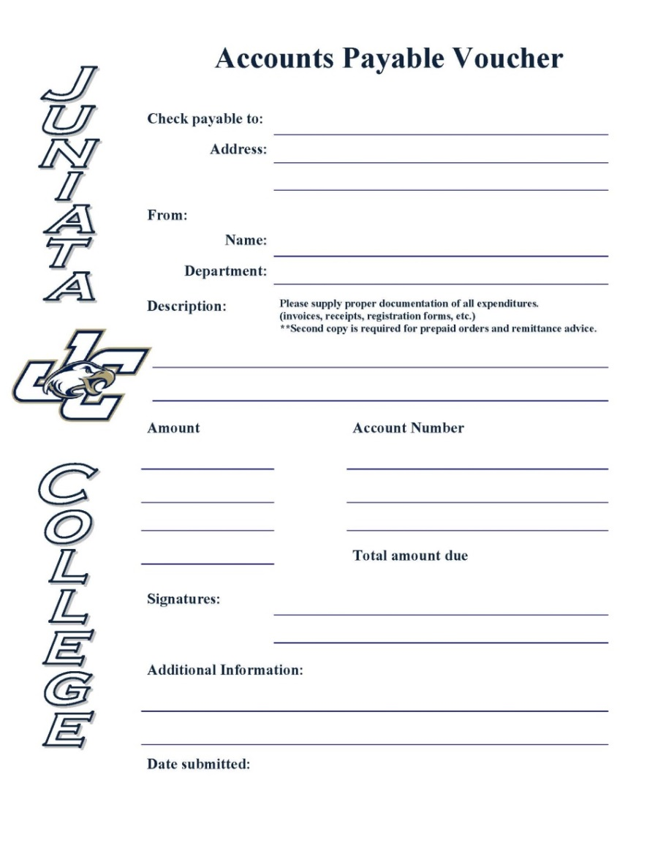
Accounts Payable Voucher
For reimbursement or a payment greater than $100
  Will be in the form of a check
Append the object code 6199 to your account number
  21-AAAAA-6199
Bring to Erika Slocum in the Accounting Office. Checks will be mailed out unless stated otherwise.
Check requests require two signatures -Treasurer along with any combination of President, Advisor, or SECA if no one else can sign.
All requests are to be submitted by Tuesday at 4pm for Thursday processing.

Slide 21
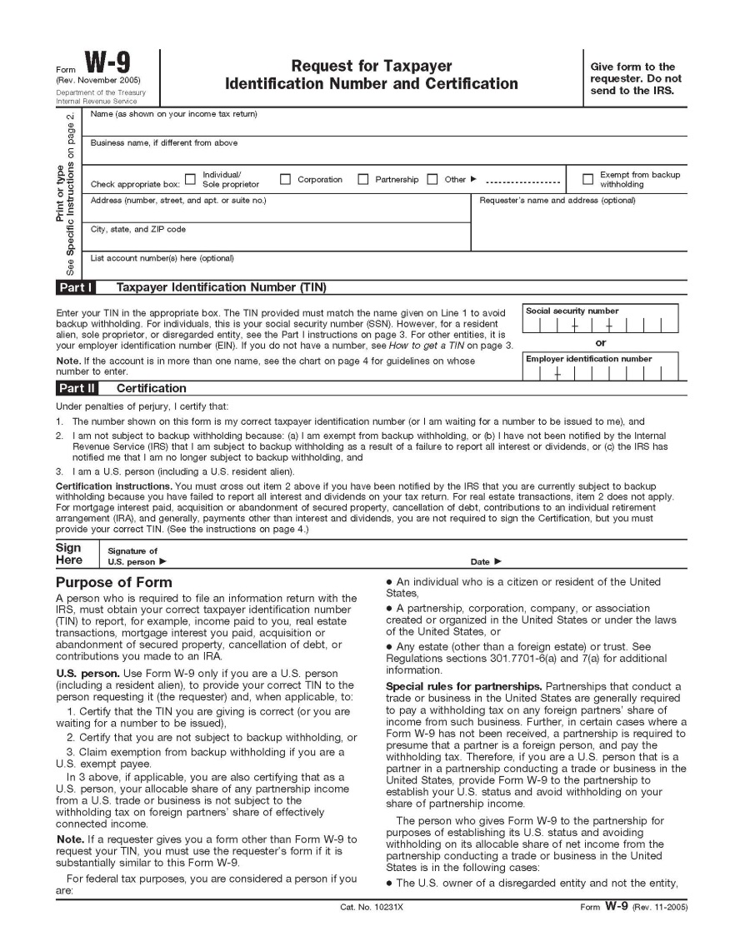
W-9’s
Used to pay an outside vendor a set amount
Complete an Accounts Payable Voucher, a W-9 Form, and you must have a contract for the vender
Give these items to Erika Slocum in the Accounting Office
Notes:
Need to double check that this goes to Erika and not Betty

Slide 22
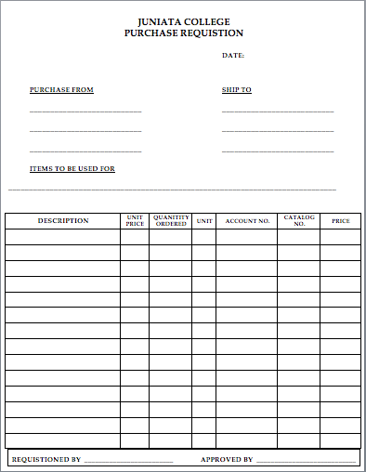
Purchase Order Form
Used for when companies do not accept p-cards or checks
Complete the “Purchase Requisition Form”
Submit to Erika Slocum in Accounting Services (include quote from company and required signatures.)

Slide 23
Tax Exemption
Tax Exempt & Tax Exempt Cards
  JC should not be charged tax; our tax exempt number is on the pcard.
  Tax Exempt Cards:
    Cannot use tax exempt w/ Personal Credit Card, but works with CASH.
    Wal-Mart (grey card) - hand to cashier before they ring up anything
      must be returned at the end of the year with P-Card.
    Dollar General - requires a form from JC.
    Dollar Tree - complete form at the store.
    Michael’s - complete form at the store.
    AC Moore - have them look in the book, form should be on file.

Slide 24
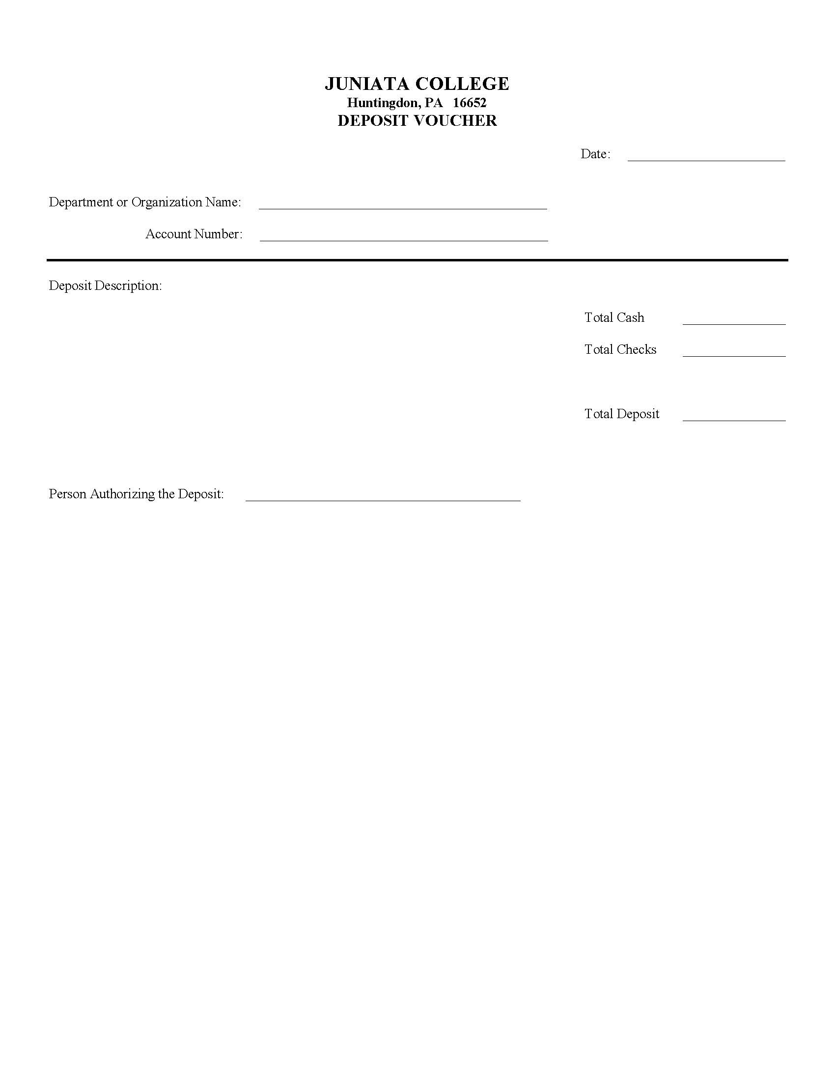
Deposits
Append the object code 4829 to your account number
  21-AAAAA-4829
Bring the Deposit Form and the cash/checks to the Bursar’s Office to Deposit
Notes:
Make a copy of the deposit form before turning it in
Keep the slip from the bursar’s office

Slide 25
Petition For Additional Funds
If your RSO needs additional funding for an event during the year, complete the “Petition for Funds (for RSOs)
Try to adhere to the Allocations Rubric when possible
You will present your petition to the Allocations Board for approval
  Your CIS representative will assist you in preparing for your presentation

Slide 26
RSO Approval and Allocations Board
RSO Approval Board
  Purpose: This student is to represent their clubs’ CIS category on the RSO Approval Board. The Allocations Board reviews, discusses, and votes on financial petitions and allocations from RSOs.
  Requirements: The individual must be a member of an RSO within the designated CIS category.
Allocations Board
  Purpose: This student is to represent their clubs’ CIS category on the Allocations Board. The Allocations Board reviews, discusses, and votes on financial petitions and allocations from RSOs.
  Requirements: The individual must be a treasurer of an RSO within the designated CIS category or have served on Allocations Board in the past.
Process
  Indicate interest on sign in sheet or tell Erin before leaving today
  Only one person interested? Congrats!
  More than one? Electronic ballot

Slide 27
Questions?
Before Leaving:
  Please review your club information and let Erin know any changes
  Indicate if you are interested in RSO Approval Board or Allocations Board

