Slide 1
RSO Officers Training
2018-2019

Slide 2
Welcome
Please Sign In:
https://goo.gl/forms/drTtTAKL1ZXgQ4Xt1

Slide 3
Introductions
Erin Paschal - Director of Student Engagement and Campus Activities
Erika Slocum – Account Payable Specialist
Rebecca Walsh – SECA JA
Naomi Frey – SECA JA
Kirwin Seger – Student Government Treasurer
TBA - Student Government Vice President

Slide 4
Office Locations
SECA
  2nd Floor Ellis Hall, across from Eagle’s Landing
  Email paschae@Juniata.edu to set up an appointment
Information Desk
  Ellis Lobby
  General Inquiries: event planning, account balance, how to form a club, access to office supplies
  8:30am – 8pm, M-F
Bursar’s Counter & Accounting Office
  IH Brumbaugh House (17th Street and Mifflin)
  Erika Slocum and Bursar Counter
  10am – 3pm, M-F

Slide 5
Training Agenda
Event Policies and Procedures
Working with Advisors
Club Resources
Questions
Treasurers: Budget Information and Paperwork
Questions

Slide 6
Juniata Student Club Hazing Policy
Dan Cook-Huffman, Associate Dean of Students
  What is hazing?
  How to recognize it?
  How to report it?

Slide 7
Traveling Off Campus
Requirements
  Vehicle Safety Training
  Participation Agreement
Safety Rules
  Cell Phone
  Seatbelts
  Speed Limits
Vehicle Usage
  College Vehicles – college insurance
  Personal Vehicles – no college insurance
All off-campus trips (more than 10 miles) must be registered!
SECA Webpage – Forms – Event Planning Forms - Travel Form
Notes:
The College’s insurance policy does not cover the use of privately-owned vehicles for College-sanctioned travel

Slide 8
BYOB Events
Registration Form
  Two weeks prior to event
Meeting with Director of SECA
TIPS Trained Individuals Present
  $7.25/hr/person

Slide 9
Events Involving Minors
Background screenings must be completed for each student working the event
  Criminal Background Check
  Child Abuse Screening
*Please note – screenings can take up to two months to complete.

Slide 10
Equipment Inspections
Equipment deemed necessary for the safety of participants and owned by the club must remain up to industry standards.
SECA may work with your club to schedule annual inspections of your equipment to ensure its compliance.

Slide 11
Copyright Requirements
Film licenses are required!

Slide 12
Working with Parkhurst
Catering Guides
Right of First Refusal
Reserving Baker
  Cultural Dinners

Slide 13
Posting Policy
Overview
  Applies across campus constituencies
  Content Neutral
  Designated Posting Areas
  11x17 Inches for Postings
  Painters Tape Required
  No Windows of Glass Surfaces
  Identification of Group or Individual and Date
    Event Specific - remove within 48 hours of event date
    No Event - may remain posted for 2 weeks
Exemptions
  Email paschae@Juniata.edu or seca@Juniata.edu
Full Policy
  SECA – Forms – Campus Posting Policy
Posting Policy Violation

Slide 14
RSO Resources
RSO Handbook – SECA Webpage
Event Registration Form – SECA Webpage
RSO Closet - Information Desk
Office Supplies – Information Desk
Juniata Brand Usage – Arch

Slide 15
Working with Your Advisor

Slide 16
Optional Upcoming Trainings
Club Recruitment
Event Planning 101 & Effective Marketing
Working with Your Advisor
Traveling Off-Campus
How to Effectively Transition your Club

Slide 17
Not Optional Trainings
Service Clubs
  1-hour overview with Director of Service Learning
Clubs with Higher Risk
  1-hour overview with SECA and Assistant Director of Human Resources and Risk Management
Club Sports
  1-hour overview with SECA; scheduling to vary

Slide 18
Questions?

Slide 19
Take a little break

Slide 20
Check Back In
https://goo.gl/forms/cfmQowaWZN93OXWs2

Slide 21
RSO Budgets Overview
Requesting Funding in Spring
  Petitions for Additional Funding
Current Budget Amounts and Account Code
  Account Number: 21-AAAAA-XXXX
  Object Codes:
    Expenses – 6199
    Deposits – 4829
You are responsible for maintaining your records
  Keep your receipts and transaction records!

Slide 22
Purchases
Purchasing Cards (P-Cards)
Reimbursements
Payment Advances
Purchase Order

Slide 23
Purchasing Cards (P-Cards)
Terms and Conditions
  Must have at least $800 in your RSO account
  Only the president, treasurer and/or advisor can be named on the card, and the only persons that can make purchases
  However it is the treasurer’s responsibility for ALL purchases, receipts, accurate account information, etc.
Lost Card
  Please report lost card immediately to Betty McKim; only one (1) chance to lose a card; on your second time you will lose your P-Card privileges for the remainder of the school year.

Slide 24
P-Cards (cont.)
Schedule of when P-Card Receipts are due:
  All P-Card receipts must be placed in the Treasurer folder that was given to you. All receipts must be signed by the treasurer of the club.
  All P-Card receipts are due by 12:00 p.m. on the 28th day of the month or the next business day if the 28th falls during a weekend.
    Email reminders will be sent. There should be no excuses for not having receipts turned in on time and that “you did not know” when receipts were due.

Slide 25
P-Card Policies
Consequences of Late Receipts/No Receipts
  1st time: Warning
  2nd time: P-Card will need to be turned into Erika Slocum for the remainder of the school year.
Change in Officers
  If there is a change in officers, please email SECA at seca@juniata.edu with your updates immediately.
  If there is a change in the Treasurer position, the current Treasurer must return the visa card and grey Wal-Mart card directly to Erika Solcum.
    If officers have changed and we find out otherwise, you will lose your P-Card privileges.

Slide 26
Payment Requests
Append the object code 6199 to your account number
  21-AAAAA-6199
Bring the form and the receipt from the purchase to the I.Harvey Brumbaugh building
  Bursar’s Counter will be located on 1st floor, in office directly to the left
  Open between 10am – 3pm
Must place request by Tuesday at noon for funds to be processed by Friday morning
Advances will be deposited directly to your personal bank account
Form found online at http://www.juniata.edu/offices/student-engagement-and-campus-activities/forms.php
Notes:
Make a copy of the receipt and the form before turning them in
Keep the slip from the bursar’s office

Slide 27
Reimbursements
You may not reimburse tax
Append the object code 6199 to your account number (21-AAAAA-6199)
Bring the form and the receipt from the purchase to I. Harvey Brumbaugh to receive reimbursement to your personal bank account

Slide 28
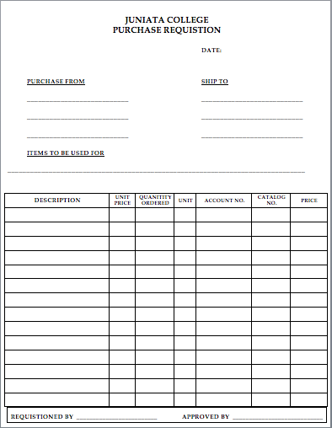
Purchase Order Form
Used for when companies do not accept p-cards or checks
Complete the “Purchase Requisition Form”
Submit to Erika Slocum in Accounting Services (include quote from company and required signatures.)

Slide 29
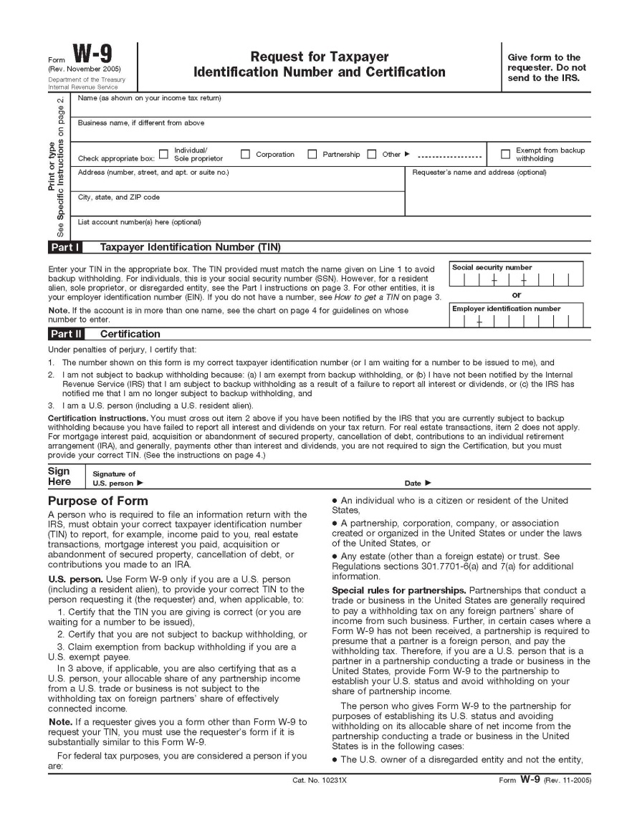
W-9’s
Used to pay an outside vendor a set amount
Complete an Accounts Payable Voucher, a W-9 Form, and you must have a contract for the vender
Give these items to Erika Slocum in the Accounting Office
Notes:
Need to double check that this goes to Erika and not Betty

Slide 30
Tax Exemption
Tax Exempt & Tax Exempt Cards
  JC should not be charged tax; our tax exempt number is on the pcard.
  Tax Exempt Cards:
    Cannot use tax exempt w/ Personal Credit Card, but works with CASH.
    Wal-Mart (grey card) - hand to cashier before they ring up anything
      must be returned at the end of the year with P-Card.
    Dollar General - requires a form from JC.
    Dollar Tree - complete form at the store.
    Michael’s - complete form at the store.
    AC Moore - have them look in the book, form should be on file.

Slide 31
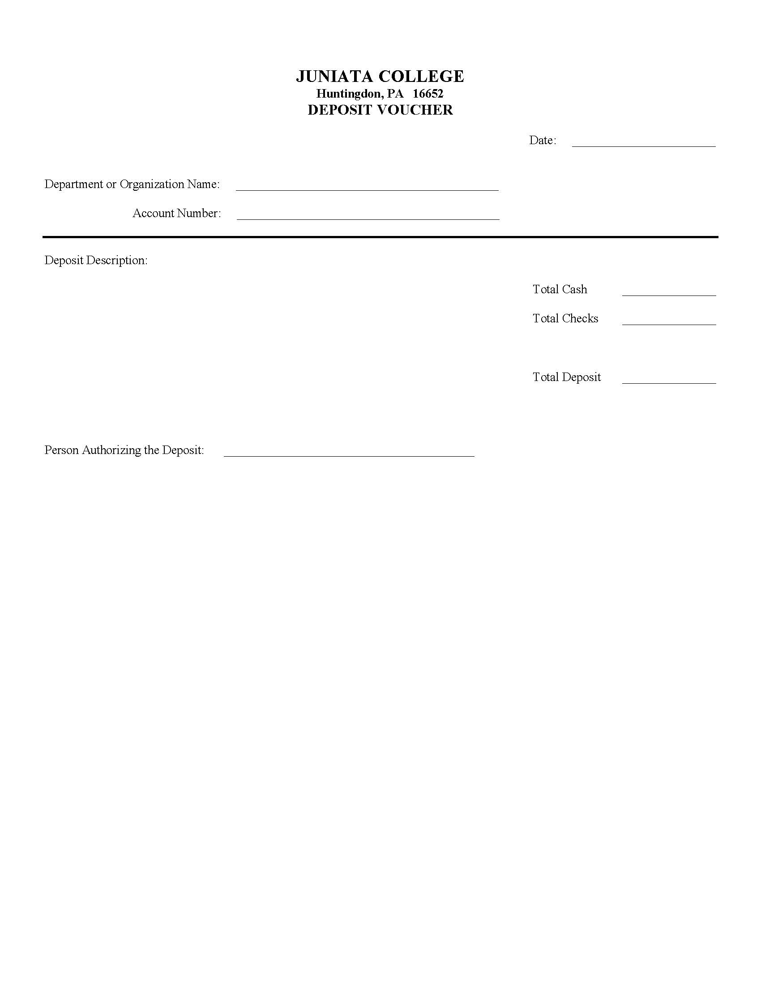
Deposits
Append the object code 4829 to your account number
  21-AAAAA-4829
Bring the Deposit Form and the cash/checks to the I.Harvey Brumbaugh to Deposit
Notes:
Make a copy of the deposit form before turning it in
Keep the slip from the bursar’s office

Slide 32
Petition For Additional Funds
If your RSO needs additional funding for an event during the year, complete the “Petition for Funds (for RSOs)
Try to adhere to the Allocations Rubric when possible
You will present your petition to the Allocations Board for approval

Slide 33
Club Debt Policy
Clubs that end the year in debt, can request allocations for the upcoming year
Those clubs will not, however be allocated funds to cover the remaining debt

Slide 34
Questions?

