Slide 1
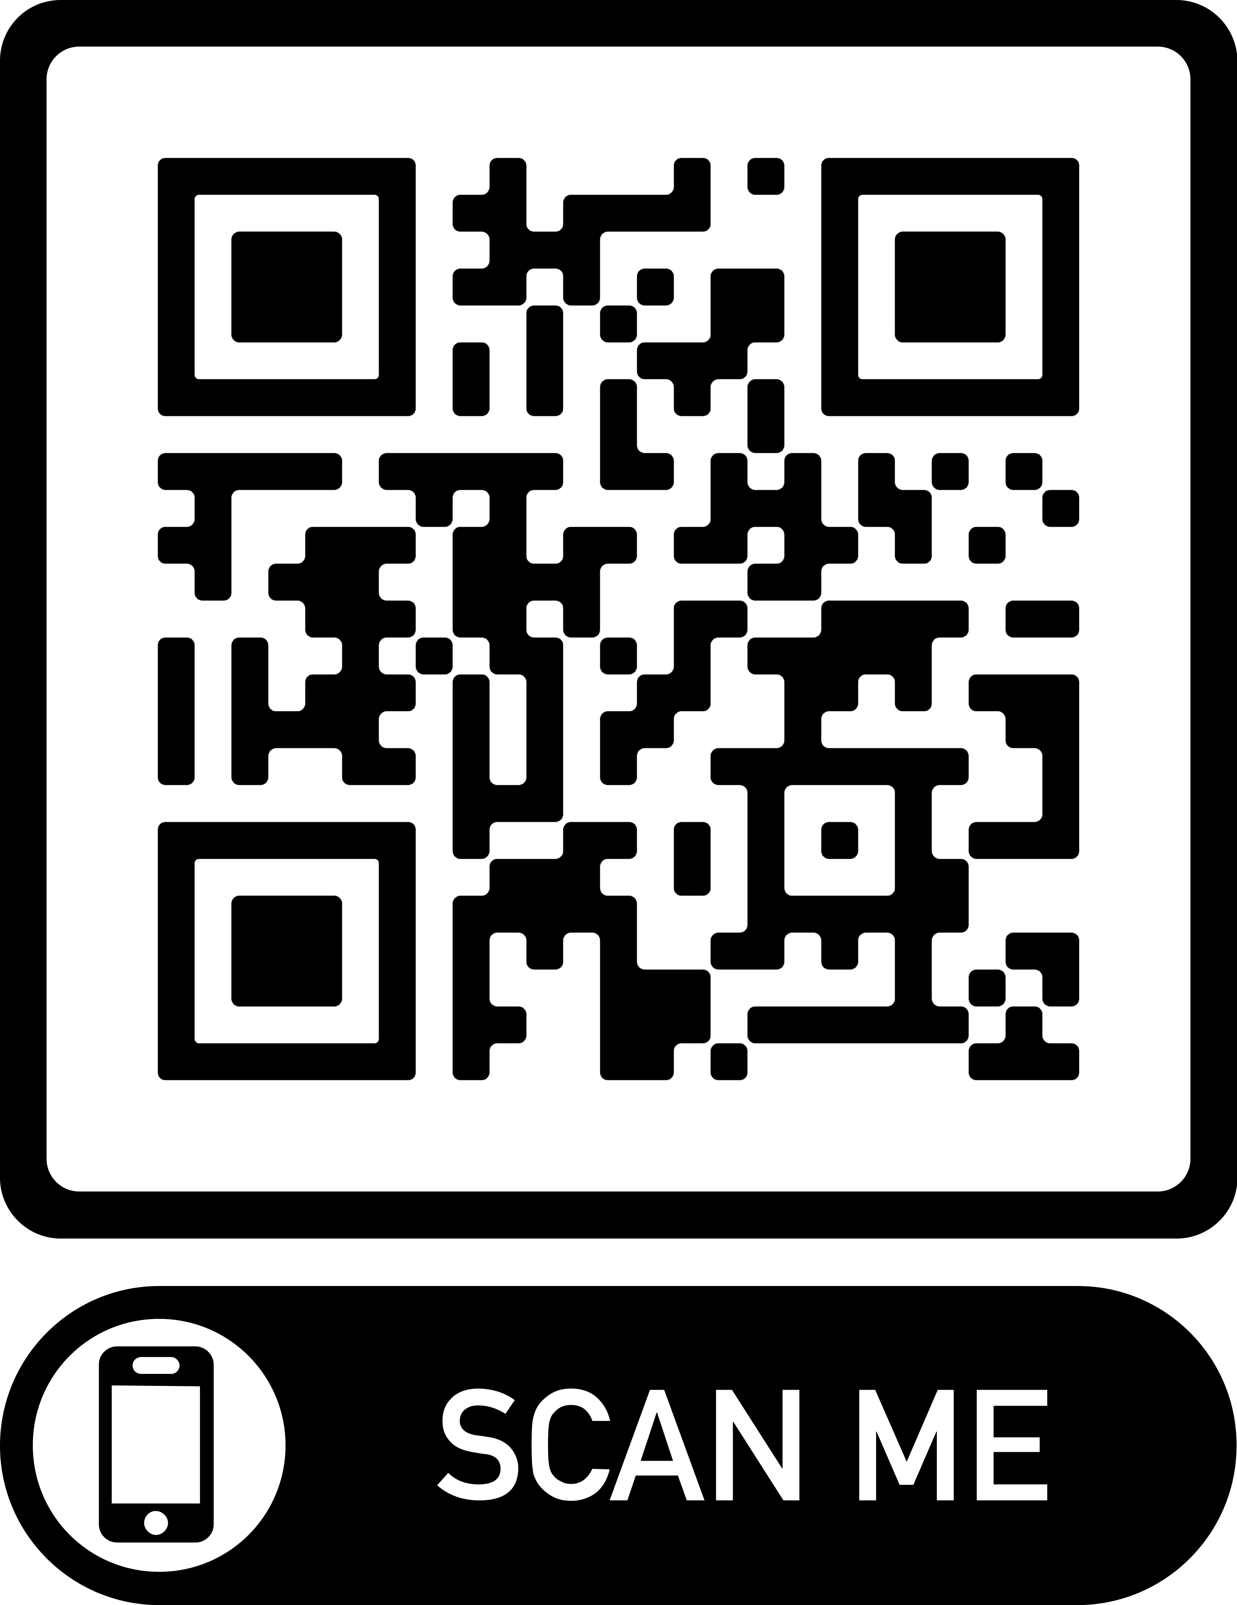
RSO Officers Training
2019-2020

Slide 2
Welcome
Please Sign In:
https://forms.gle/eNqE84fAZa2ufqNa6

Slide 3
Introductions
Erin Paschal – Assistant Dean of Students for Campus Life
Erika Slocum – Director of Accounting
Chris Heasley – Residential Life Coordinator
Dan Cook-Huffman – Associate Dean of Students
Naomi Frey – SECA JA
Student Government Treasurer
Student Government Vice President
Stephanie Meyers – Assistant to CFO (Pcards)

Slide 4
Office Locations
Campus Life (SECA)
2nd Floor Ellis Hall, across from Eagle’s Landing
Email seca@Juniata.edu for questions and appointments
Bursar’s Counter & Accounting Office
IH Brumbaugh House (17th Street and Mifflin)
Erika Slocum, Steph Meyers, and Bursar Counter
10am – 3pm, M-F

Slide 5
Training Agenda
Event Policies and Procedures
Working with Advisors
Club Resources
Questions
Treasurers: Budget Information and Paperwork
Questions

Slide 6
Juniata Student Club Hazing Policy
Dan Cook-Huffman, Associate Dean of Students
What is hazing?
How to recognize it?
How to report it?

Slide 7
Traveling Off Campus
Requirements
Vehicle Safety Training
Participation Agreement
Safety Rules
Cell Phone
Seatbelts
Speed Limits
Vehicle Usage
College Vehicles – college insurance
Personal Vehicles – no college insurance
All off-campus trips (more than 10 miles) must be registered!
SECA Webpage – Forms – Event Planning Forms - Travel Form
Notes:
The College’s insurance policy does not cover the use of privately-owned vehicles for College-sanctioned travel

Slide 8
BYOB Events
Registration Form
Two weeks prior to event
Meeting with a representative from Campus Life
TIPS Trained Individuals Present
$7.25/hr/person

Slide 9
Events Involving Minors
Background screenings must be completed for each student working the event
Criminal Background Check
Child Abuse Screening
All Forms must be submitted to Campus and Residential Life one week prior to the event.
*Please note – screenings can take up to two months to complete.

Slide 10
Equipment Inspections
Equipment deemed necessary for the safety of participants and owned by the club must remain up to industry standards.
SECA may work with your club to schedule annual inspections of your equipment to ensure its compliance.
*If you have not signed up for a time to pick up your equipment, it will be repurposed.*

Slide 11
Copyright Requirements
Film licenses are required!
Email seca@Juniata.edu with requests

Slide 12
Working with Parkhurst
Catering Guides & Catertrax
Right of First Refusal

Slide 13
Posting Policy
Overview
Applies across campus constituencies
Content Neutral
Designated Posting Areas
11x17 Inches for Postings
Painters Tape Required
No Windows of Glass Surfaces
Identification of Group or Individual and Date
Event Specific - remove within 48 hours of event date
No Event - may remain posted for 2 weeks
Exemptions
Email seca@Juniata.edu
Full Policy
SECA – Forms – Campus Posting Policy
Posting Policy Violation

Slide 14
RSO Resources
RSO Handbook – SECA Webpage
Event Registration Form – SECA Webpage
RSO Closet – Campus and Residential Life Desk
Office Supplies –Campus and Resident Life Desk
Juniata Brand Usage – Arch

Slide 15
Working with Your Advisor

Slide 16
Optional Upcoming Trainings
Club Recruitment
Event Planning 101 & Effective Marketing
Working with Your Advisor
Traveling Off-Campus
How to Effectively Transition your Club

Slide 17
Not Optional Trainings
Service Clubs
1-hour overview with Director of Service Learning
Clubs with Higher Risk
1-hour overview with SECA and Assistant Director of Human Resources and Risk Management
Club Sports
1-hour overview with SECA; scheduling to vary

Slide 18
Questions?

Slide 19
Take a little break

Slide 20
Check Back In
https://forms.gle/eNqE84fAZa2ufqNa6
^Make sure to sign-in if you haven’t!

Slide 21
RSO Budgets Overview
Requesting Funding in Spring
Petitions for Additional Funding
Current Budget Amounts and Account Code
Account Number: 21-AAAAA-XXXX
Object Codes:
Expenses – 6199
Deposits – 4829
You are responsible for maintaining your records
Keep your receipts and transaction records!

Slide 22
Purchases
Tax Exemption
Purchasing Cards (P-Cards)
Payment Requests
Purchase Order

Slide 23
Tax Exemption
Tax Exempt & Tax Exempt Cards
JC should not be charged tax; our tax exempt number is on the pcard.
Tax Exempt Cards:
Cannot use tax exempt w/ Personal Credit Card, but works with CASH.
Wal-Mart (grey card) - hand to cashier before they ring up anything
must be returned at the end of the year with P-Card.
Dollar General - requires a form from JC.
Dollar Tree - complete form at the store.
Michael’s - complete form at the store.
AC Moore - have them look in the book, form should be on file.

Slide 24
Purchasing Cards (P-Cards)
Terms and Conditions
Must have at least $800 in your RSO account
Only the president, treasurer and/or advisor can be named on the card, and the only persons that can make purchases
However it is the treasurer’s responsibility for ALL purchases, receipts, accurate account information, etc.
Lost Card
Please report lost card immediately to Erika Slocum or Steph Meyers; only one (1) chance to lose a card; on your second time you will lose your P-Card privileges for the remainder of the school year.

Slide 25
P-Cards (cont.)
Schedule of when P-Card Receipts are due:
All P-Card receipts must be placed in the Treasurer folder that was given to you. All receipts must be signed by the treasurer of the club.
All P-Card receipts are due by 12:00 p.m. on the 28th day of the month or the next business day if the 28th falls during a weekend.
Email reminders will be sent. There should be no excuses for not having receipts turned in on time and that “you did not know” when receipts were due.
RED FOLDERS WILL BE AVAILABLE AS OF FRIDAY, SEPT. 6
AT NOON IN CAMPUS & RESIDENTIAL LIFE

Slide 26
P-Card Policies
Consequences of Late Receipts/No Receipts
1st time: Warning
2nd time: P-Card will need to be turned into Erika Slocum for the remainder of the school year.
Change in Officers
If there is a change in officers, please email SECA at seca@juniata.edu with your updates immediately.
If there is a change in the Treasurer position, the current Treasurer must return the visa card and grey Wal-Mart card directly to Steph Meyers.
If officers have changed and we find out otherwise, you will lose your P-Card privileges.

Slide 27
Payment Request Form
Contracts
W9 & Contract
Invoices
Reimbursements
Receipts
Payment Advances
Advance Clear

Slide 28
Contracts
Contracts may only be signed by Erin Paschal
Set an appointment at least 2 weeks prior to event
Bring the following:
Contract
Completed PA1099
Completed W9

Slide 29
Payment Requests
Bring the form and accompanying information to the I.Harvey Brumbaugh building
Bursar’s Counter will be located on 1st floor, in office directly to the left
Open between 10am – 3pm
Must place request by Tuesday at noon for funds to be processed by Friday morning
Advances and reimbursements will be deposited directly to your personal bank account
Forms found online at http://www.juniata.edu/offices/student-engagement-and-campus-activities/forms.php
Notes:
Make a copy of the receipt and the form before turning them in
Keep the slip from the bursar’s office

Slide 30
Deposits
Append the object code 4829 to your account number
21-AAAAA-4829
Bring the Deposit Form and the cash/checks to the I.Harvey Brumbaugh to Deposit
Notes:
Make a copy of the deposit form before turning it in
Keep the slip from the bursar’s office

Slide 31
Petition For Additional Funds
If your RSO needs additional funding for an event during the year, complete the “Petition for Funds (for RSOs)
Try to adhere to the Allocations Rubric when possible
You will present your petition to the Allocations Board for approval

Slide 32
Club Debt Policy
Clubs that end the year in debt, can request allocations for the upcoming year
Those clubs will not, however be allocated funds to cover the remaining debt

Slide 33
Questions?

